Slide 1
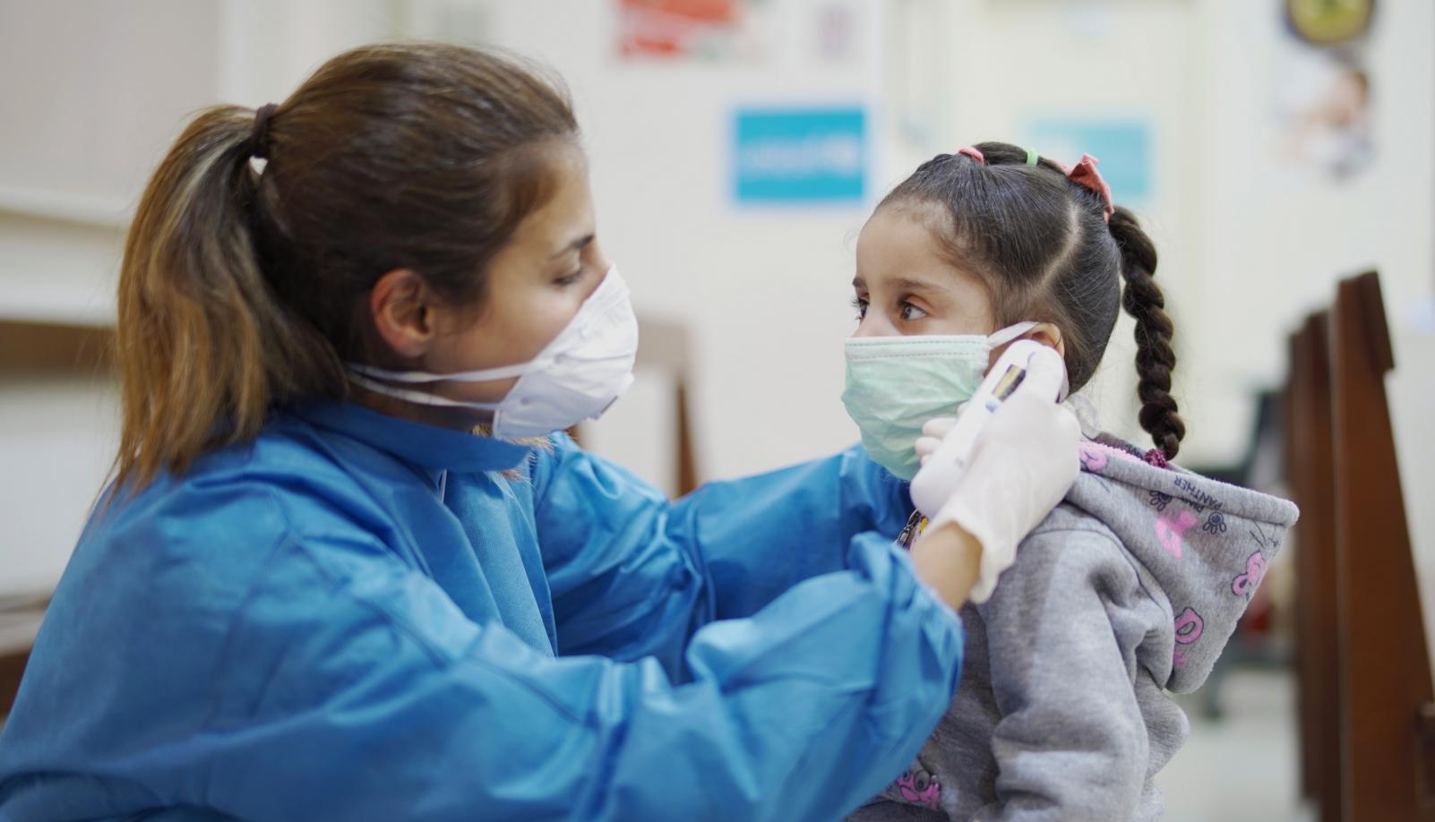

Webinar
RCCE Indicators for the
COVID-19 response
10 June 2020
© UNICEF/UNI317998/Choufany

Slide 2
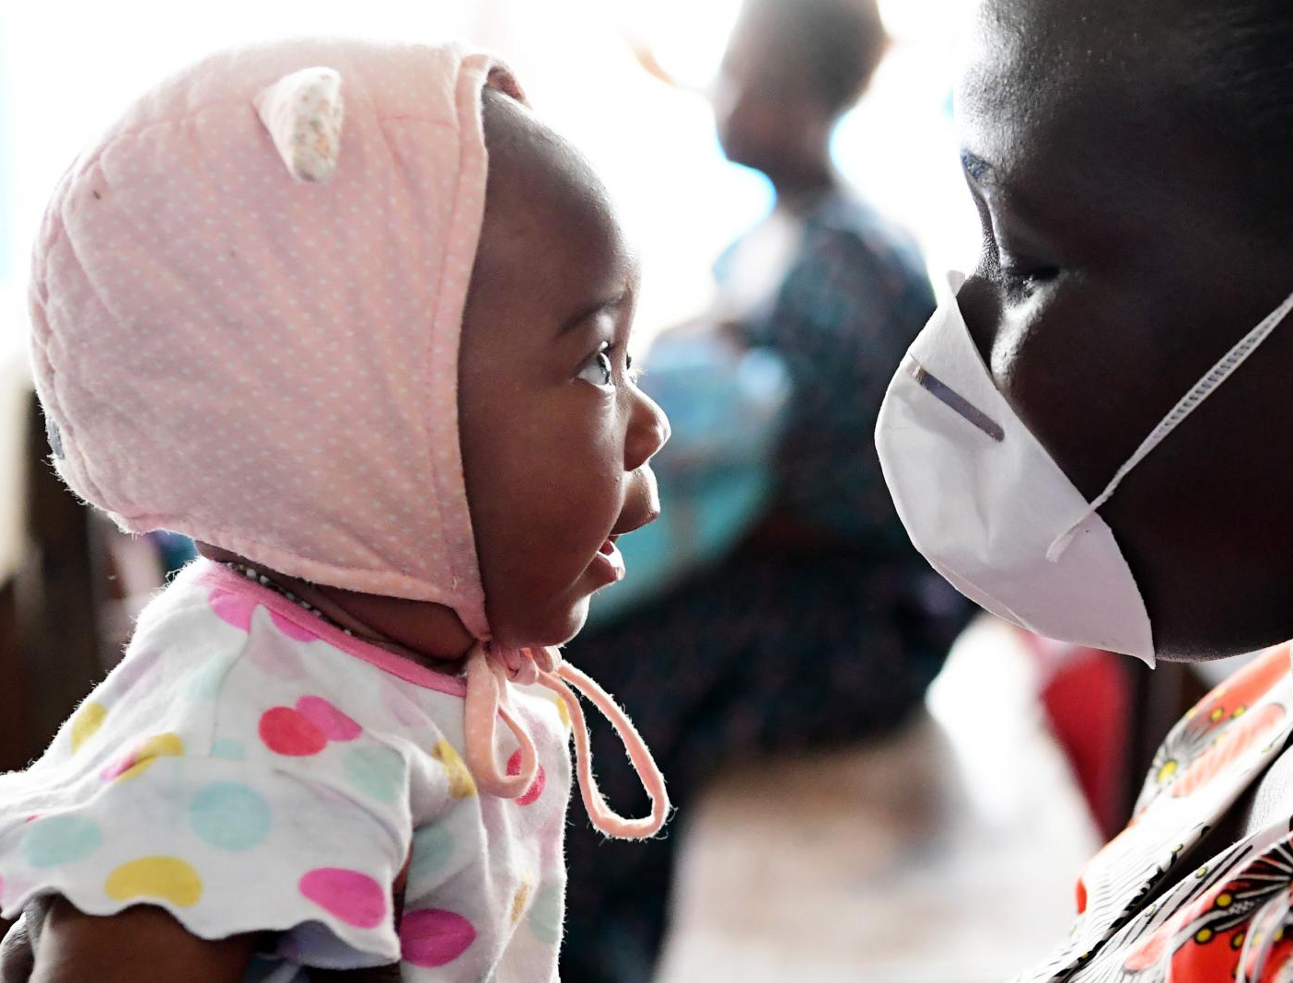
Session Overview
Provide an overview on the HPM/HAC Risk Communication and Community Engagement (RCCE) indicators for COVID-19, guidance documents
Clarify additional guidance on digital platforms metrics and data collection and reporting
Get feedback on the guidance and further required support

Slide 3

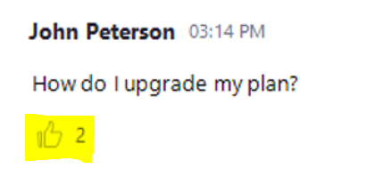
Housekeeping issues
Please use the “Q&A” function in the bottom bar instead of “Chat” to post your questions:
Click “thumbs-up” if you share the same question with a colleague – the question will be upvoted!
The slides, recording, and all questions raised in Q&A will be shared after the webinar.

Slide 4
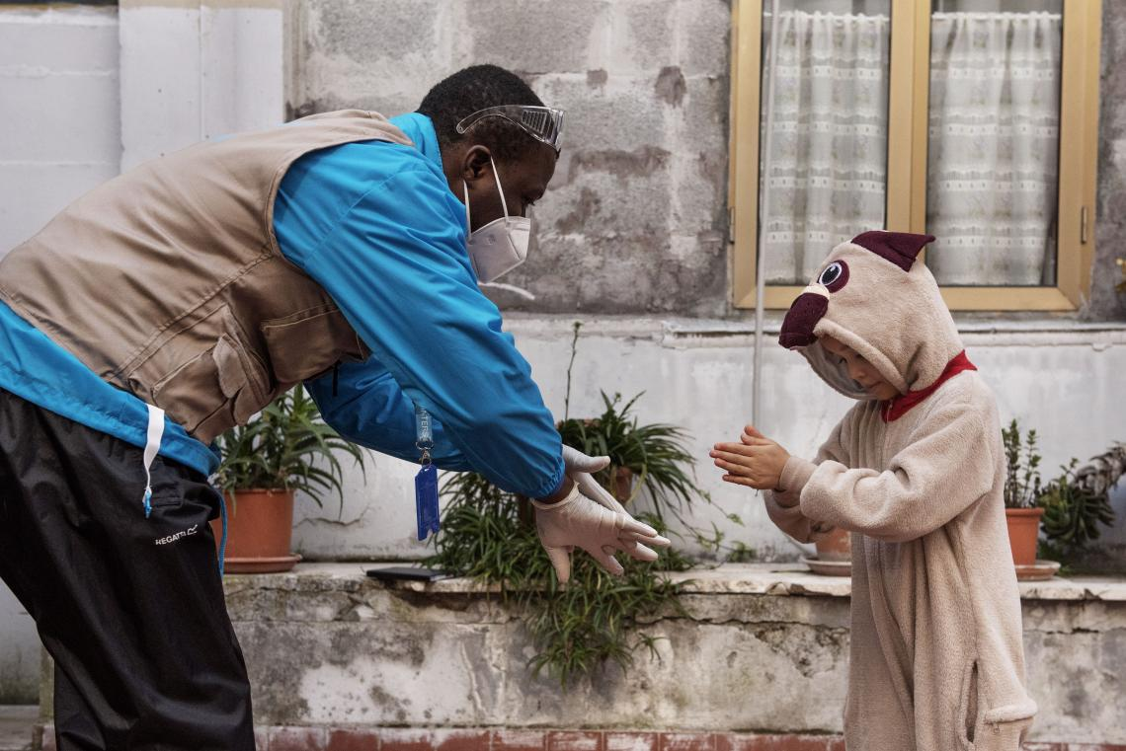
RCCE Indicators for the COVID-19 Response
Actions to facilitate two-way communication, dialogue, meaningful participation and local action
#1
Reach
#3
Feedback
#2
Engage
Systems to promote accountability
One-way communications
(mass messaging)
Notes:
Mention Indicator Guidance + Q&A – summarizes key information on data collection, measurement, and indicators for RCCE COVID response
Strengthens UNICEF accountability

Slide 5
What are we measuring
DOUBLE-COUNTING CONSIDERATIONS
Conduct audience research – identify most used channels/platforms
Aggregate different populations reached via separate channels/platforms, if they are tracked through accurate measurements.
Use the platform with the “highest number” of population reached, given the same geographical conditions / population targets, for reporting
Double counting could be internally analyzed for reach to target populations, effectiveness, access, and profiles of target populations/audiences.
# people reached by messaging
# people participated in engagement actions
# people feedback across types – complaints, queries, perceptions, suggestions, concerns
Notes:
Inter-dependency across interventions being measured -
How is feedback informing new messaging or CE actions

Slide 6
Examples of CO-level tools to disaggregate SitRep/HAC data
“Number of people reached on COVID-19 through messaging on prevention and access to services”
Platforms used | # Reached | Audience | Key message | MOV
Radio
TV
WhatsApp
Social Media (specify platform, e.g. Facebook, Twitter, etc.)
Health unit/HCW
Informal communications (family, friends)
Community health workers
RCRC volunteers
Community mobilizers
Community leaders
Religious leaders
Traditional healers
Traditional midwives
Any other platform/ channel/mobilizer
Total
Notes:
Platforms / “formats”

Slide 7
Examples of CO-level tools to disaggregate HAC data
“# of People who participate in COVID-19 engagement actions”
Engagement platform /actions | # People/ Users | Operational Indicators | Sector (C4D, WASH, Health) | MOV
Interactive digital, cell/mobile phone, social media engagements
Interactive media programs (especially community radio, talk shows)
Active/voluntary communication and outreach in one’s community
Participation in community needs assessment and evaluation
Participation in planning, implementation, and monitoring of COVID-19 community interventions and action plans
Participation in data collection, analysis, and reporting practices
Active dialogue to respond to rumors and misinformation
House-to-house / home visits
Participation in community dialogues, including with leaders and key influencers, frontline workers, in specific groups (e.g. Youth groups), etc.
Other engagement platform
Total

Slide 8
Examples of CO-level tools to disaggregate HAC data
“# of feedbacks, concerns, questions and clarification requests on available support services received through established feedback mechanisms”
Feedback mechanism | # users/ audience | Type of contact* | Theme/Issue | # contacts resolved | # leading to change in response or services | MOV
Hotlines, information centers
Digital engagement platforms (U-report, RapidPro, IoGT, others)
Interactive messaging platforms (Facebook, Twitter, WhatsApp)
Participation in research on community insights
Written communications (email, letters)
Q & A forums, listening sessions
Media Call-ins (TV, radio programs )
Community platforms, feedback booths
Other feedback mechanisms/platforms
Total
*Types of contact = Concerns, complaints and feedback, rumors and misinformation. Information about COVID-19, access to COVID-19 support services
Notes:
# leading to policy change - this at a different level

Slide 9
Disaggregate Data by Audience & Platforms, as relevant
Each Country Office should disaggregate data by gender, age, identified vulnerable and marginalized sub-populations, and persons with disabilities in accordance with UNICEF and country RCCE strategies and plans. Data should also be disaggregated by platform to analyze reach, engagement, and feedback gaps in national RCCE performance delivery.
Audience | # Reached # Engaged # Feedback | Platforms / Mechanisms (see next slides, adapt/revise according to RCCE national plans)
M/F | M
 | F
Age | Children (0-17)
 | Adolescents
 | Adults (18 and above)
Vulnerable or marginalized populations | Urban/informal settlements
 | Refugees/Migrants/IDPs/returnees
Persons w/disabilities
Total
Notes:
Suggested: age, sex, marginalized/vulnerable group, disability; channels used; type of message/programme area
Disability – integrate “multiple formats and channels” - this includes, at a most basic level, ensuring that all messages are provided in written, audio and pictorial format (so as to reach people with hearing, visual and intellectual disabilities or low literacy)

Slide 10
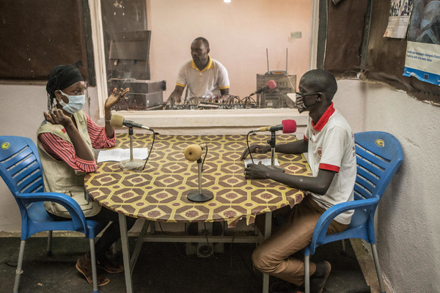
Traditional Media
MEDIA TYPE | REACH | ENGAGEMENT | FEEDBACK
Traditional Media Including TV, radio, online and print media | # of people reached through TV/radio/print/online news | # of people engaged through interactive radio and TV platforms/programs | Context-specific and locally decided indicators on closing the feedback loop and available support services
Key considerations:
Getting reliable data on traditional media - particularly TV viewership and radio listenership – is a challenge in many countries. Here are some tips:
For print and online news, monitoring tools such as LexisNexis Newsdesk or similar include reach figures (circulation/average monthly visitors)
TV & radio: Most global monitoring tools include very limited local TV and radio channels, especially in certain regions. COs may get broadcast data from a media monitoring agency or from the broadcaster itself.
Other sources for country-level data: Government statistics; survey and polling data (I.e. Gallup, Pew, UNICEF or other orgs). Consider relevance of the methodology, sample, and other factors to your work.
Use your best judgment and be conservative when estimating.
©UNICEF/UNI332878/Keïta

Slide 11
Social Media and Web
Media type | REACH | ENGAGEMENT | FEEDBACK
Social Media Including Facebook, Instagram, Twitter, LinkedIn and any other social media platforms used by the CO | # of impressions per COVID-19-related post [top performing channel] | # of engagements per COVID-19-related post | Locally decided indicators to monitor efforts of closing the feedback loop related to available support services
Web UNICEF COVID-19-related web pages | # of unique pageviews for COVID-related pages | Average time on page (COVID-related pages) for narrative
Key considerations
Reach: 1-way messaging. COs that use paid marketing may aggregate organic impressions + paid impressions
Engagement: 2-way communication. Standard 'engagement' actions (likes, comments, shares, reactions, RTs, etc.)
Feedback: Focus on established feedback mechanisms and accountability to affected populations. Context specific.
In the SitRep narratives, COs are encouraged to report total impressions and engagements
Support
DOC has global LTAs open to all RO/COs for media monitoring and social listening tools (LexisNexis and Talkwalker)
Step-by-step technical guidance will be shared soon.
Drop-in Zoom “office hours” with PME and digital colleagues for additional support coming soon
Notes:
Indicator 1
For COVID reporting on social media, we recommend prioritizing “impressions” comparing to “reach” (please refer to the guidelines for the differences between reach and impressions)
Social Media Indicator 1 calculation: select your top performing social media channel (e.g. Facebook) and identify the COVID-related posts. For these posts, take the total number of impressions and divide by the number of posts.
Web Indicator 1 calculation: aggregation of total number of unique views to UNICEF COVID-19-related web pages
Indicator 2
Social Media Indicator 2 calculation: Select your top performing social media channel (e.g. Facebook) and identify the COVID related posts. For these posts, take the total number of engagements and divide by the number of posts.
In the SitRep narrative, you can include the total number of social media engagements on COVID-related posts and consider also using video views
Web Indicator 2: A longer duration can indicate that users are finding the content interesting or informative.

Slide 12
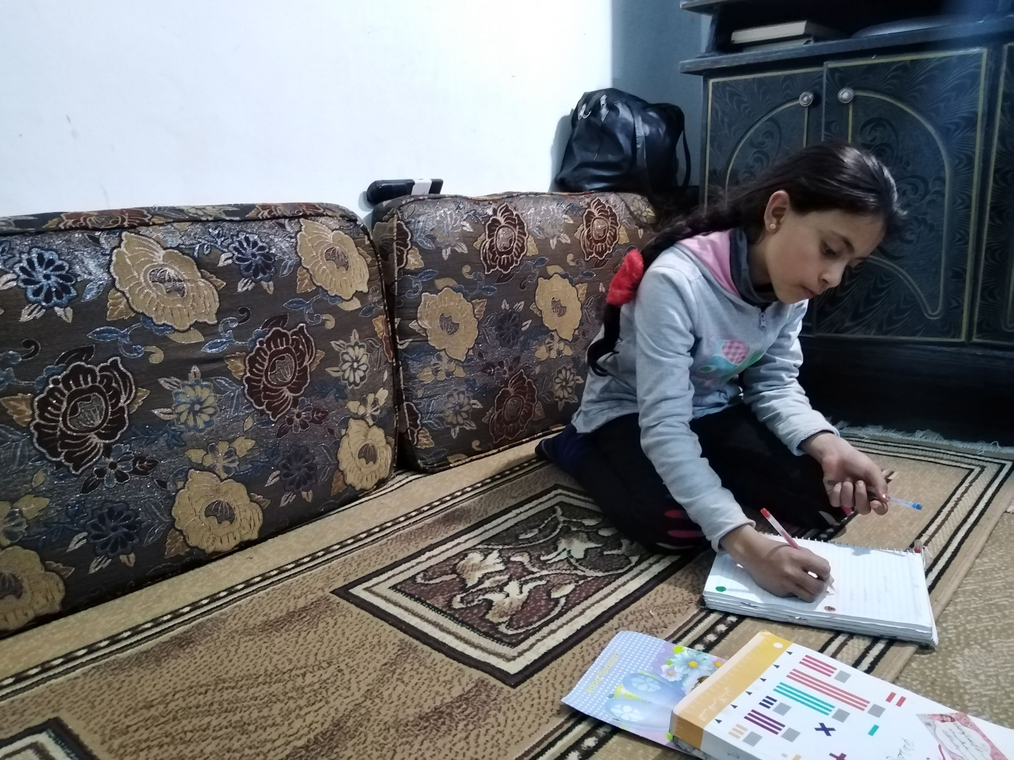
RapidPro Enabled Platforms
Media type | Reach | Engagement | Feedback
RapidPro-enabled Programmes (includes U-Report, 1000 days, chatbots,.) | # of times users were reached for COVID-19 response | # of messages received in messaging programmes that have incorporated COVID-19 content. | # of times people shared asked questions/clarifications on support services on RapidPro

Slide 13
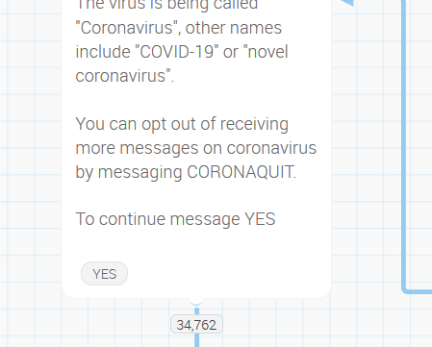
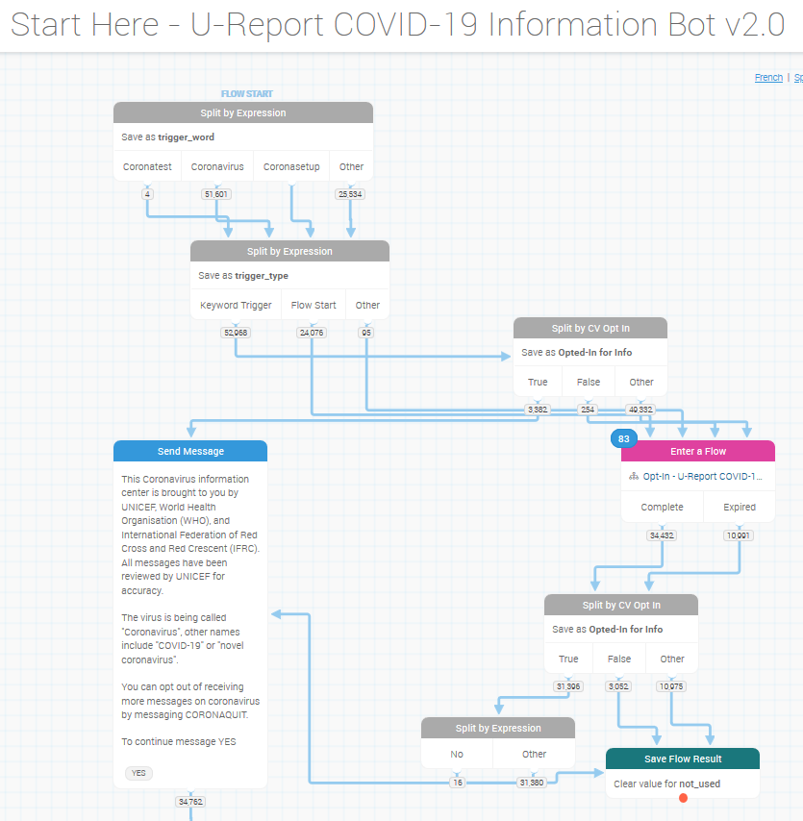
RapidPro Enabled Platforms
HAC 1 (Reach) : Number of people reached on COVID-19 through messaging on prevention and access to services
RapidPro Indicator: # of times users were reached for COVID-19 response
Definition: An aggregate of
Total number of times users were sent at least one message in a RapidPro flow for COVID-19, and
Total number of times users’ questions were answered via CasePro/U-Partners, and
Total number of users reached/times users were reached through other RapidPro activities (e.g. via RapidPro API).
The first point in a COVID-19 related flow when the user was reached with a message
Once per flow

Slide 14
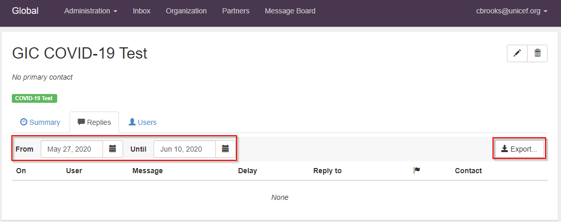
RapidPro Enabled Platforms
HAC 1 (Reach) : Number of people reached on COVID-19 through messaging on prevention and access to services
RapidPro Indicator: # of times users were reached for COVID-19 response
Definition: An aggregate of
Total number of times users were sent at least one message in a RapidPro flow for COVID-19, and
Total number of times users’ questions were answered via CasePro/U-Partners, and
Total number of users reached/times users were reached through other RapidPro activities (e.g. via RapidPro API).
CasePro / U-Partners
Under the Partners tab, select a partner that is responding to COVID-19 messages
Under the Replies header, can select a time period and export the messages
The spreadsheet export contains the message replies for the time period – these can be filtered by appropriate label and counted
Repeat for each Partner that responds to the COVID-19 messages

Slide 15
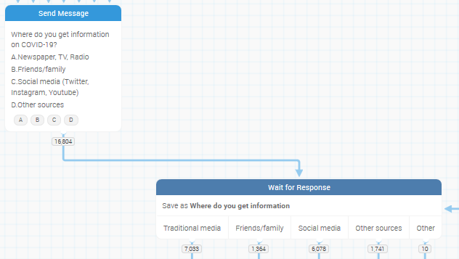
RapidPro Enabled Platforms
HAC 2 (Engagement): Number of people who participate in COVID-19 actions
RapidPro Indicator: # of messages received in messaging programmes that have incorporated COVID-19 content.
Definition: An aggregate of
# of messages received from users on COVID-19 RapidPro flows
# of messages received from users on CasePro/U-Partners platforms
# of messages received from users through other RapidPro activities (e.g. via RapidPro API).
Each time the user gives responds to a Wait for Response box, combined
For every Wait for Response box, for every flow
Normally do NOT include “Other” category (usually these are bad responses)
X

Slide 16
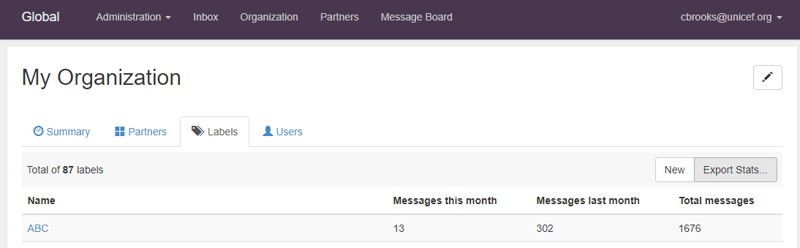
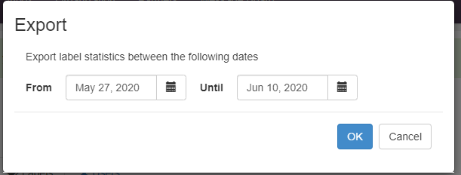
RapidPro Enabled Platforms
HAC 2 (Engagement): Number of people who participate in COVID-19 actions
RapidPro Indicator: # of messages received in messaging programmes that have incorporated COVID-19 content.
Definition: An aggregate of
# of messages received from users on COVID-19 RapidPro flows
# of messages received from users on CasePro/U-Partners platforms
# of messages received from users through other RapidPro activities (e.g. via RapidPro API).
CasePro /
U-Partners
Create one or more Labels dedicated for incoming COVID-19 messages
In the Organization tab, under the Labels header, the Total Messages (received by the platform) for each Label can be viewed
Using the Export Stats tool, the number of Messages in a given time period can be accessed

Slide 17
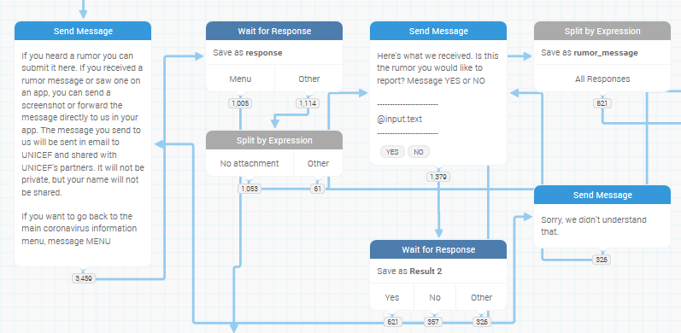
RapidPro Enabled Platforms
HAC 3 (Feedback): Number of people sharing their concerns and asking questions/ clarifications for available support services to address their needs through established feedback mechanisms
RapidPro Indicator: # of times people shared asked questions/clarifications on support services on RapidPro
Definition: An aggregate of
# of times people
  answered polls
  submitted questions, myths, or other information
… through automated chatbots which can inform UNICEF’s programmatic interventions,
# of times people sought referral services on RapidPro-enabled programmes, and
# of times people asked questions to be fielded on CasePro/U-Partners platforms
Each time the user completes the key action
  Answering a poll question
  Submitting rumor
  Sought referral information
Normally do NOT include “Other” category (usually these are bad responses)

Slide 18
RapidPro Enabled Platforms
HAC 3 (Feedback): Number of people sharing their concerns and asking questions/ clarifications for available support services to address their needs through established feedback mechanisms
RapidPro Indicator: # of times people shared asked questions/clarifications on support services on RapidPro
Definition: An aggregate of
# of times people
  answered polls
  submitted questions, myths, or other information
… through automated chatbots which can inform UNICEF’s programmatic interventions,
# of times people sought referral services on RapidPro-enabled programmes, and
# of times people asked questions to be fielded on CasePro/U-Partners platforms
Can be collected from CasePro/U-Partners in the same way as HAC 2/Engagement
Consider whether each incoming message fits the HAC 3 definition

Slide 19
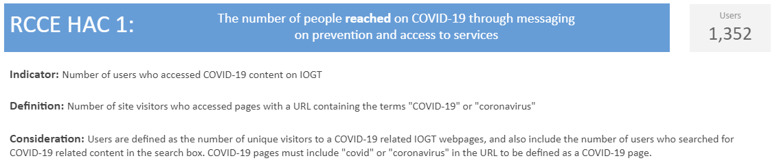
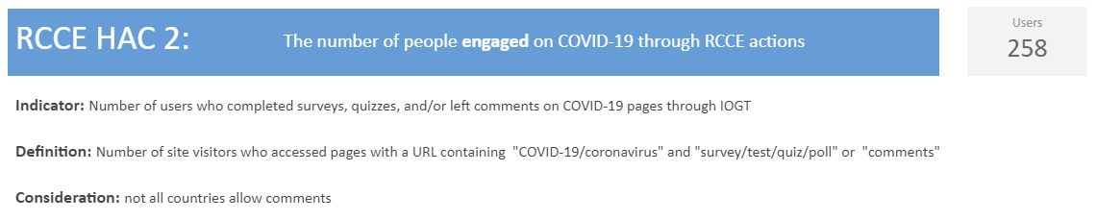
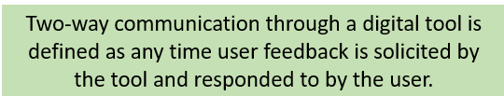
Internet of Good Things

Slide 20
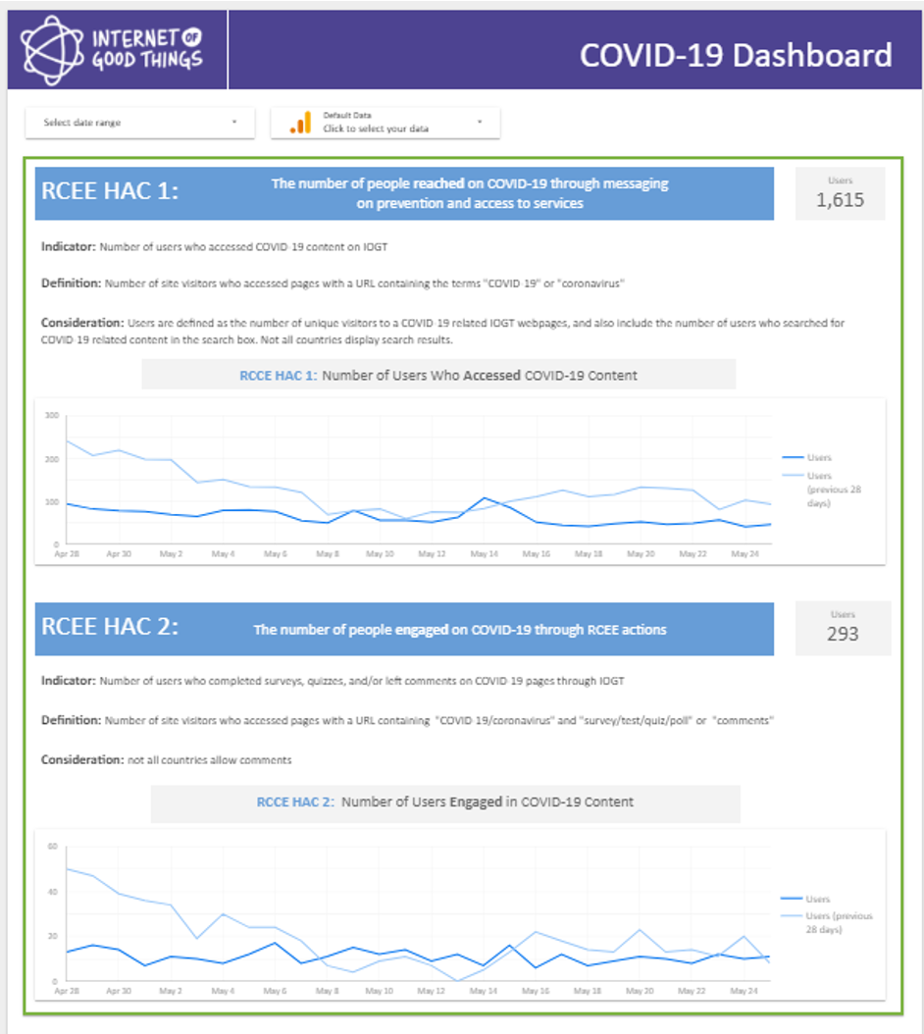
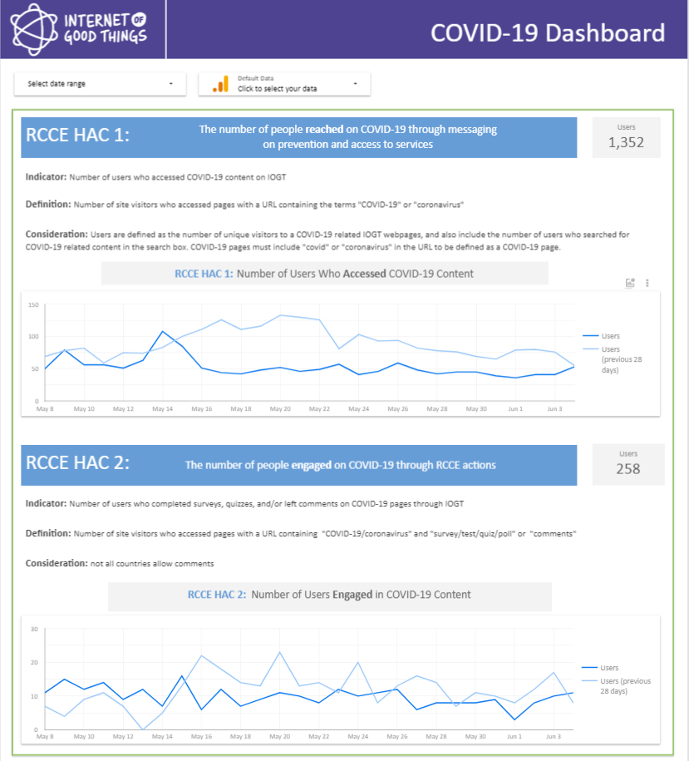
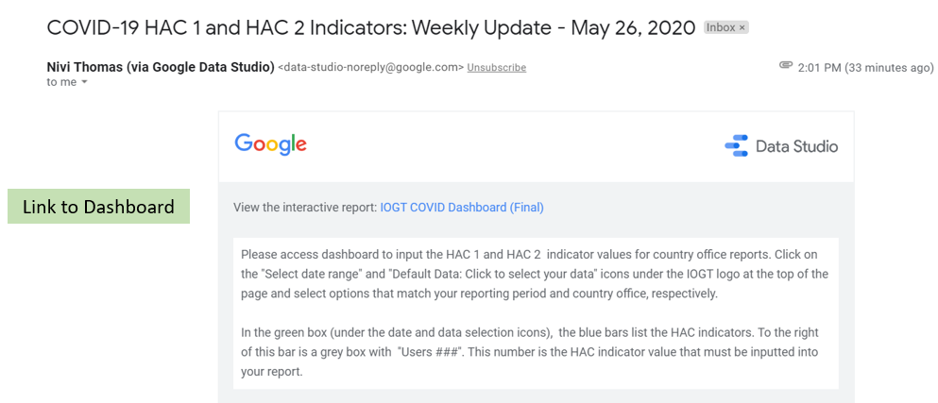
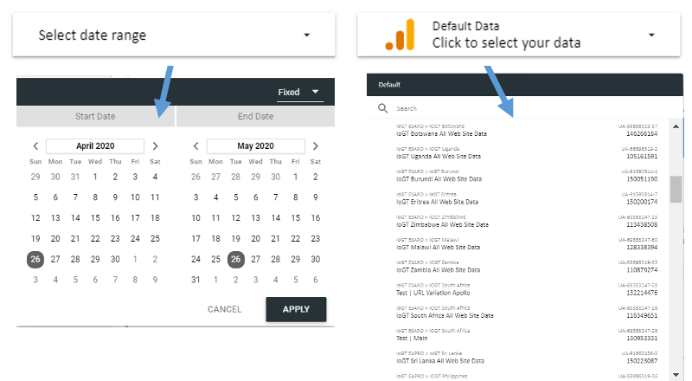
Internet of Good Things
3. Record HAC 1 and HAC 2 values
1. Click link to dashboard in weekly email alert
2. Change date and data to match data report needs for country office

Slide 21
Other Locally-Supported Digital Platforms
RCCE HAC Indicator | Guidance
1 | Number of unique users reached with COVID-19-related messages. Ignored prompts do not qualify for reach reporting but can be used to inform programmatic decision-making around priority messages and audience preferences. Effort should be made, where possible, to disaggregate reach by audience type (i.e. gender, age, location, profession).
2 | Number of unique, two-way user engagements completed (without regard to the number of unique users).
3 | Number of unique users who share personal stories related to COVID-19 or who request, via a workflow-based engagement or open-ended response, clarity or support related to COVID-19.

Slide 22
Disaggregate Data by Audience & Platforms, as relevant
Each Country Office should disaggregate data by gender, age, identified vulnerable and marginalized sub-populations, and persons with disabilities in accordance with UNICEF and country RCCE strategies and plans. Data should also be disaggregated by platform to analyze reach, engagement, and feedback gaps in national RCCE performance delivery.
Audience | # Reached # Engaged # Feedback | Platforms / Mechanisms (see next slides, adapt/revise according to RCCE national plans)
M/F | M | In Country XX - Community influencers trained; Community members identify vulnerable groups; community-based outreach; U-report polls conducted; Chatbot; TV and radio information dissemination; social media; IOGT; National Hotline and community feedback centers
 | F
Age | Children (0-17)
 | Adolescents
 | Adults (18 and above)
Vulnerable or marginalized populations | Urban/informal settlements
 | Refugees/Migrants/IDPs/returnees
Persons w/disabilities
Total
Notes:
Suggested: age, sex, marginalized/vulnerable group, disability; channels used; type of message/programme area
Disability – integrate “multiple formats and channels” - this includes, at a most basic level, ensuring that all messages are provided in written, audio and pictorial format (so as to reach people with hearing, visual and intellectual disabilities or low literacy)

Slide 23
How to avoid double counting? Some scenarios
Count once when the same group of people/same geographical areas reached with messages multiple times or through multiple platforms:
People reached multiple times:
    A population of 10,000 reached with information on COVID19 through a dedicated radio program for five days every week then the total number of people reached
- Weekly total = 10,000 NOT 50,000 (counting daily reach)
- Monthly total = 10,000 as well, because we reached the same group of people multiple times
People reached through multiple platforms:
A population of 10,000 reached with messages through Radio (every day); same 10,000 reached through a TV program (every day); and same 10,000 received messages through a social media platform. The total number of people reached is:
- Weekly total = 10,000 NOT 30,000 (adding up 10,000 each for radio, TV, and social)
- Monthly total = 10,000 as well, same people received information multiple times through different platforms

Slide 24
How to avoid double counting? Some scenarios (cont.)
Aggregate the numbers when different groups of people OR different geographical areas reached with messages through different platforms
People reached through multiple platforms (different geographic areas):
A population of 10,000 reached with messages through radio (every day) in district-A; 10,000 reached through a TV program (every day) in district-B; and another 10,000 receive messages through distribution of IEC materials AND community announcements through megaphones district-C. The total number of people reached is:
        - Weekly total = 30,000 NOT 10,000 (for each platform in a different district).
        - Monthly total = 30,000 as well, because the same groups received information multiple times in the three districts through different platforms.

Slide 25
Way forward...
What are the mix of platforms for CE – based on your country context, and current COVID-19 conditions/restrictions
  which have been adopted in the CO and what are the implementation challenges?
  how are we defining targets? Geographical? Population demographics? marginalized, vulnerable groups?
  how are we aggregating our reach through different interventions?
How is the data reviewed and used by partners? Reporting platforms for decision-making? For RCCE as well as other pillars of the response?
How is the data collected informing country RCCE plans (and adapted as the response evolves?)
How are RCCE interventions changing? e.g. during the period of “deconfinement” , shifting to confinement, etc.?
Key Takeaways & Considerations
Notes:
1 page – the framework, the agenda for action, how this is driving our collective action (examples of cross cutting initiatives in support of the overall agenda I.e. with CSPs and FBOs, the group of Friends letter) and how this has been implemented nationally too.
Page2/3/4: focus on two agenda items each setting out why this is a priority and how UNICEF’s advocacy (using publications, media, social, GWAs etc) have driven public, political and programme responses which deliver for children)

Slide 26
Additional Resources
COVID RCCE Technical Guidance for Supporting Digital Platforms and Traditional Media 2.0 (18 June 2020)
Step-by-step Guidance for Social Media and Web platforms reporting
COVID SitReps global dashboard
The qualitative SitReps – periodic reports with country highlights: https://www.unicef.org/appeals/Novel%20Coronavirus_sitreps.html
UNICEF Humanitarian Appeal for Children: Novel Coronavirus (COVID-19) Response
RCCE Action Plan Guidance: COVID-19 preparedness and response (IFRC, UNICEF, WHO, 16 March 2020)
COVID-19 Global Response Risk Communication & Community Engagement Strategy (IFRC, UNICEF, WHO)
Focus Group Discussion Guide for Communities: Risk communication and community engagement for the new coronavirus (IFRC, UNICEF, WHO, 5 March 2020)
BBC Media Action. Covid-19: Guide to community engagement at a distance.
COVID-19: How to include marginalized and vulnerable people in risk communication and community engagement. (IFRC, UNICEF, WHO (2020).
CORE GROUP Polio-Global Health Security Project, COVID-19 HOUSE-TO-HOUSE COMMUNITY OUTREACH (DRAFT GUIDANCE) https://docs.google.com/document/d/166fL8UrCA1HRdDx1Xxn_8z4Mcj2ZRW2Wj8QNJmNO7pI/edit
2019 Novel Coronavirus (2019 nCoV): Strategic Preparedness and Response Plan (WHO, 3 February 2020)
Global Humanitarian Response Plan: COVID-19. United Nations Coordinated Appeal (April – December 2020) (UN OCHA, 28 March 2020)
Jeff Chelsky and Lauren Kelly, “Bowling in the Dark: Monitoring and Evaluation during COVID-19 (Coronavirus).” (World Bank Group, 1 April 2020)
WHO COVID-19 Monitoring and Evaluation Framework (WHO M&E Network)
Interagency Community Engagement Minimum Standards and Indicators, July 2019

Slide 27
Thank you
For more information, please contact:
Ehsan Ul Haq, Emergency Specialist (PME), EMOPS ehaq@unicef.org
Rania Elessawi, C4D Specialist (Social and Behavior Change), PD, relessawi@unicef.org
Natalia Vaccarezza, Communication Specialist – M&E, DOC, nvaccarezza@unicef.org
Xinyi Ge, PME Officer, DOC, xge@unicef.org
RapidPro-enabled Programmes
Matthew McNaughton, Global T4D Specialist, ICTD, rapidpro@unicef.org
Christopher Brooks, Senior Digital & Data Specialist, Innovation, cbrooks@unicef.org
Internet of Good Things (IoGT)
Laurie Markle, C4D Specialist (Global Lead of IoGT), lmarkle@unicef.org
Nivida Thomas, nividathomas@gmail.com

