Slide 1
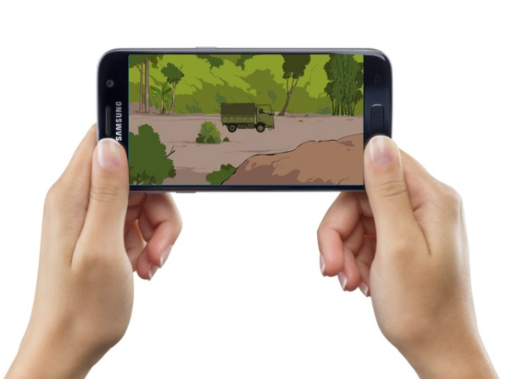
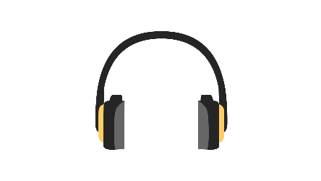

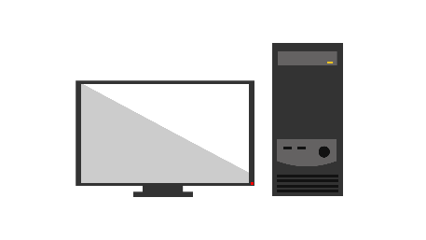






The Myanmar interactive EORE application

Slide 2
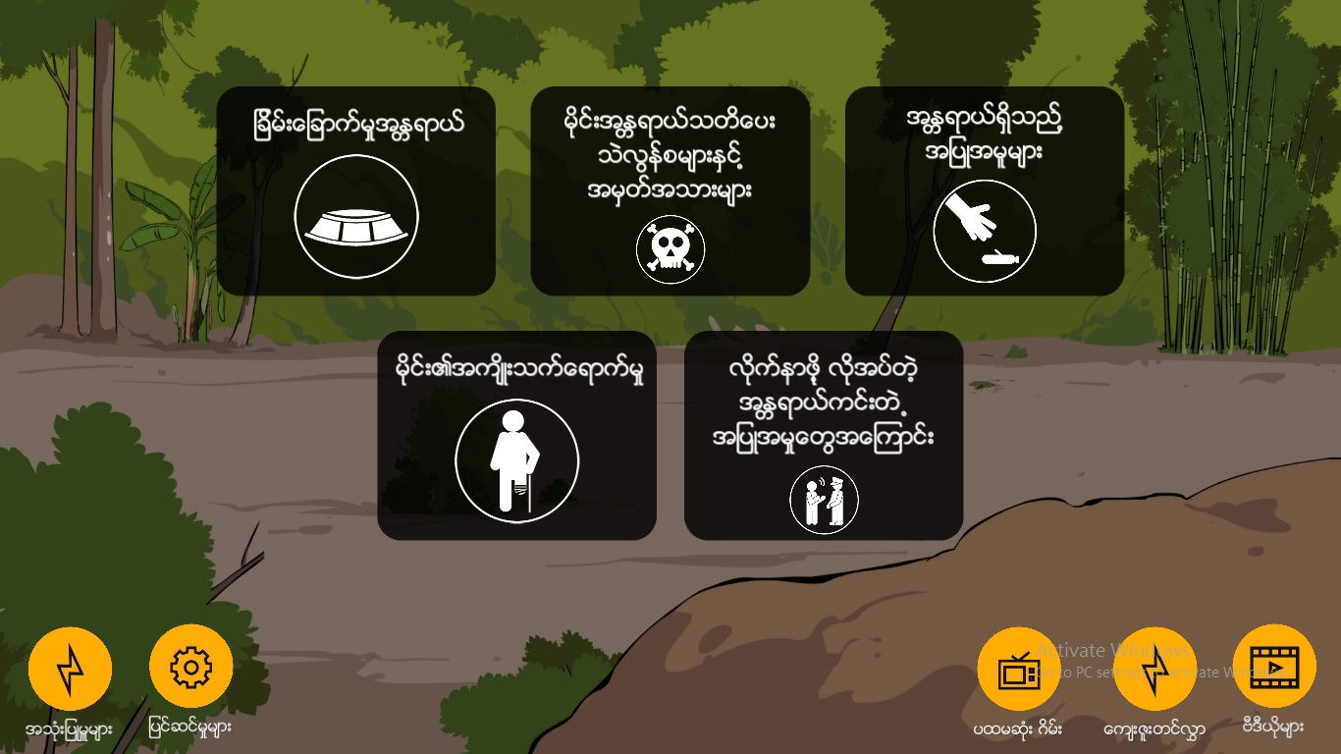
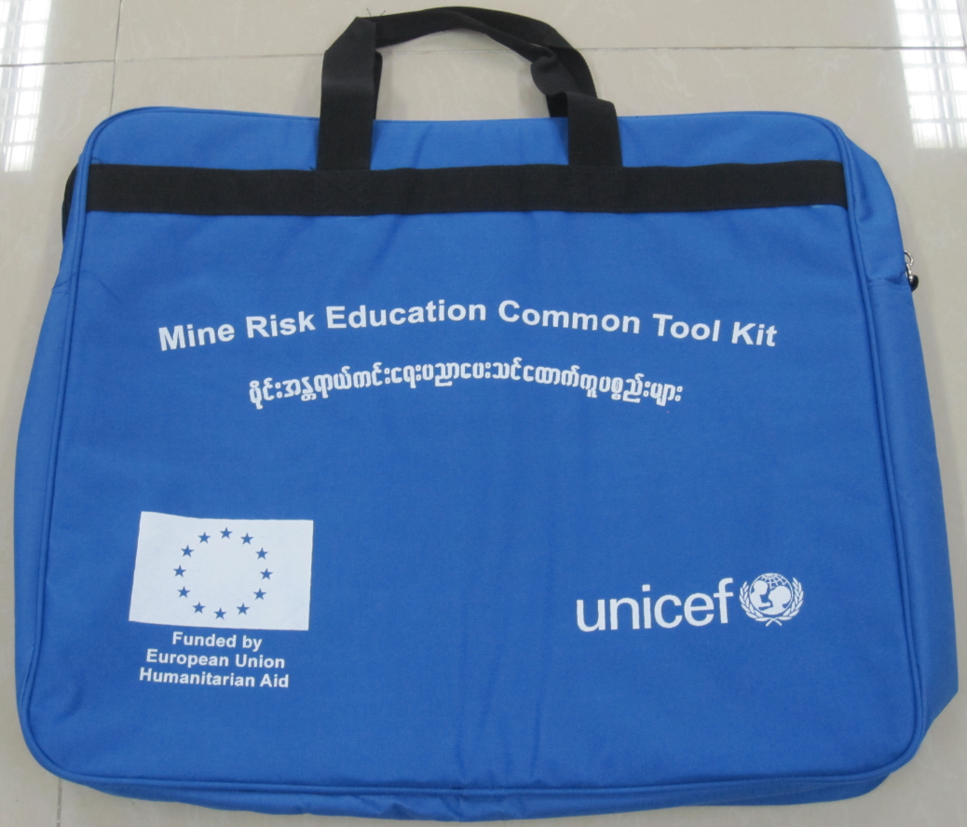
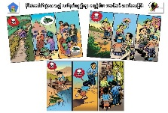
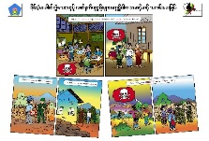
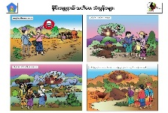

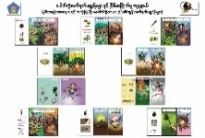
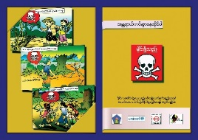
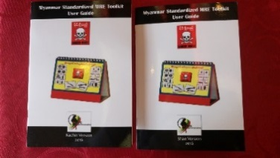
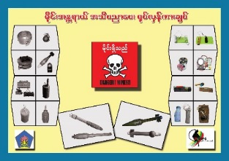
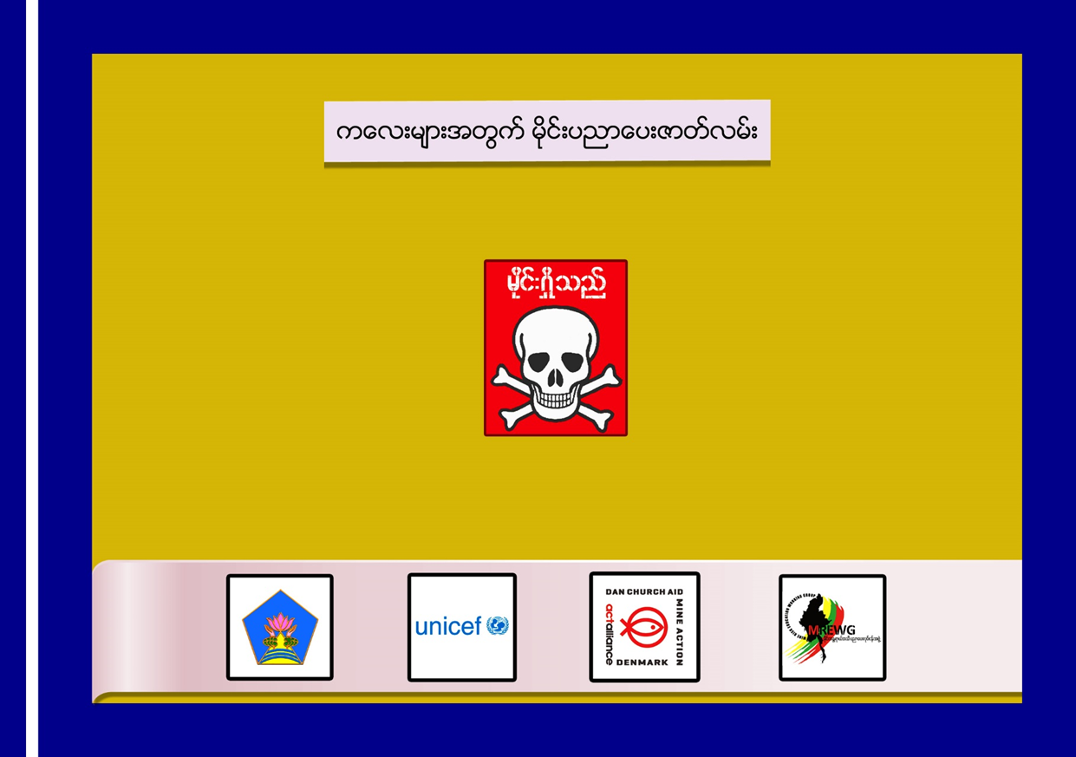
Common EORE Toolkit and Application
Common EORE Toolkit
Application based on the field tested Toolkit (2018)

Slide 3
Feature of interactive EORE application
Designed for smartphone application or computer program;
OFF LINE (no internet required for sharing);
No cost, available through distribution services such as Google Play and App Store;
Contribute to a more interactive and dynamic learning experience for users, including both EORE facilitators and target audiences;
→ Application is in: Myanmar Language

Slide 4
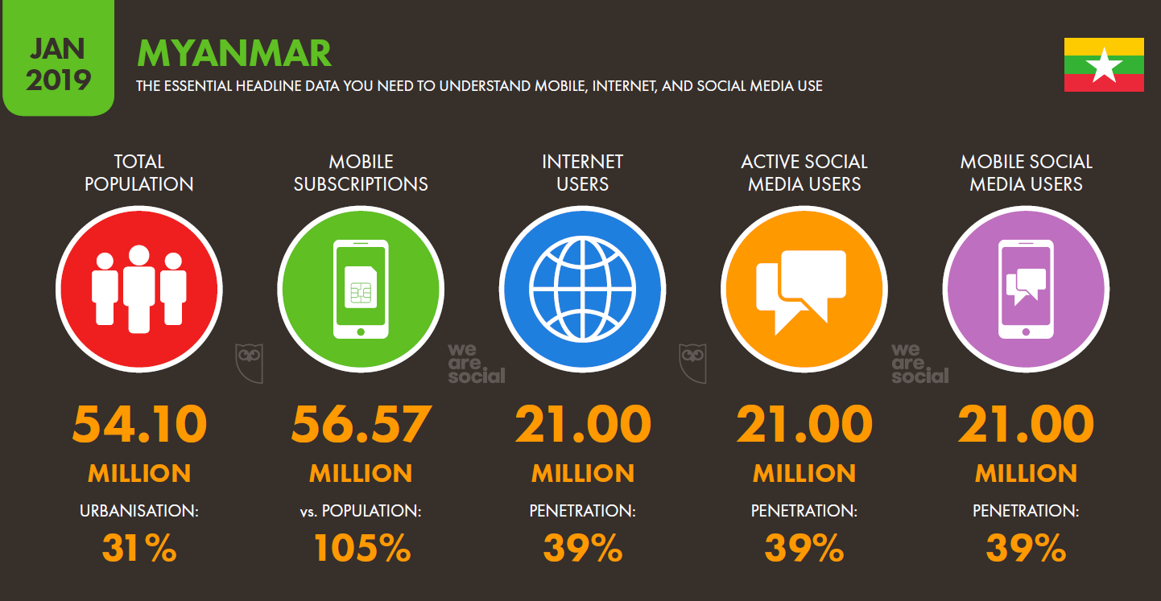
Comparative advantages of Application
Cost effectiveness: Smartphone available at 19 USD in Myanmar
Lighter to transport: Smartphones and tablets between 0.2 kg - 0.8 kg
+ easy to reach remote affected communities when no access of roads.
Cost: traditional printing MRE toolkit at 60USD per piece.
Weight: Full MRE tool kit Bag around 5kg.
Rapid growth in mobile, internet and social media use

Slide 5
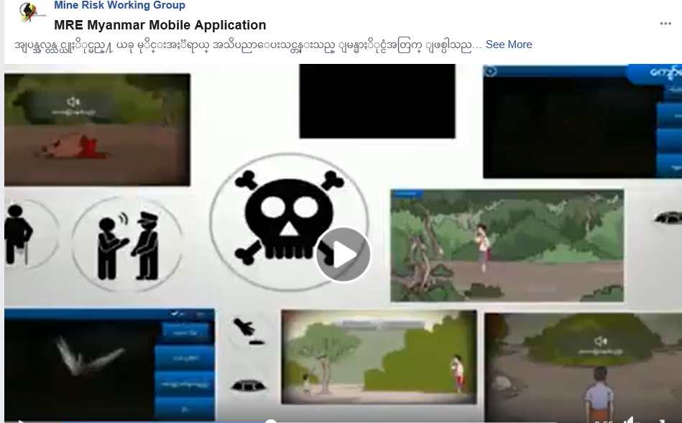
Challenges and way forward
Measuring the effectiveness of the Application.
Feedback from the users usually take times.
Planning to add additional features to provide up to date information.
Maximizing the use of Application eg, targeted location through the Facebook.

Slide 6
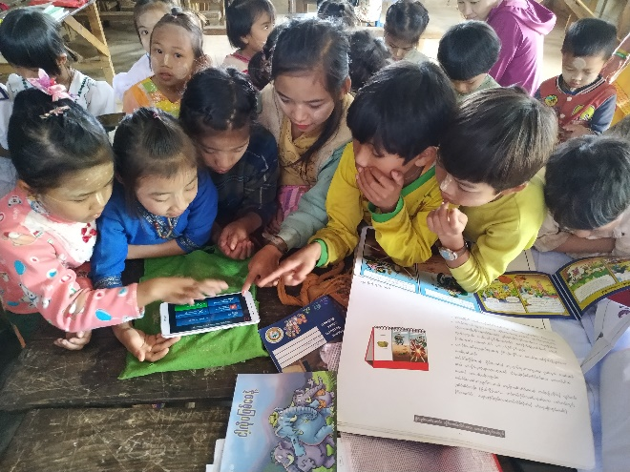
Thank you

