Slide 1

Risk education app - syria
Teaching RE to children in hard to reach areas

Slide 2
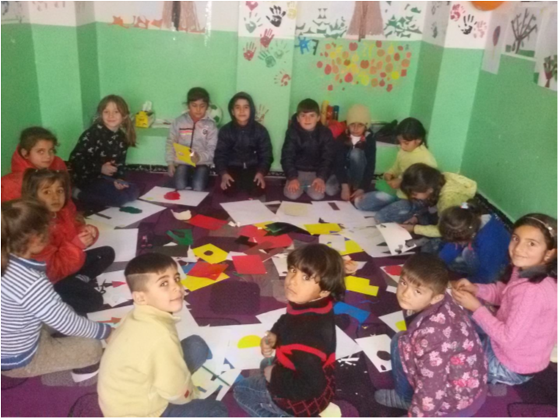

purpose
Purpose
to provide teachers located in hard-to-reach and besieged areas of Syria with knowledge about the dangers of explosive remnants of war and associated safe behaviour
to equip teachers with the tools to teach children about safe behavior in an instructive and interactive way

Slide 3
Background
Syrian partners were increasingly unable to leave Syria to receive training without facing serious threats to their safety and security
Despite electricity shortages, access to internet is still available
The use of mobile information and communication technology is widespread in the Syrian context
Possibility of updating app as threats change

Slide 4
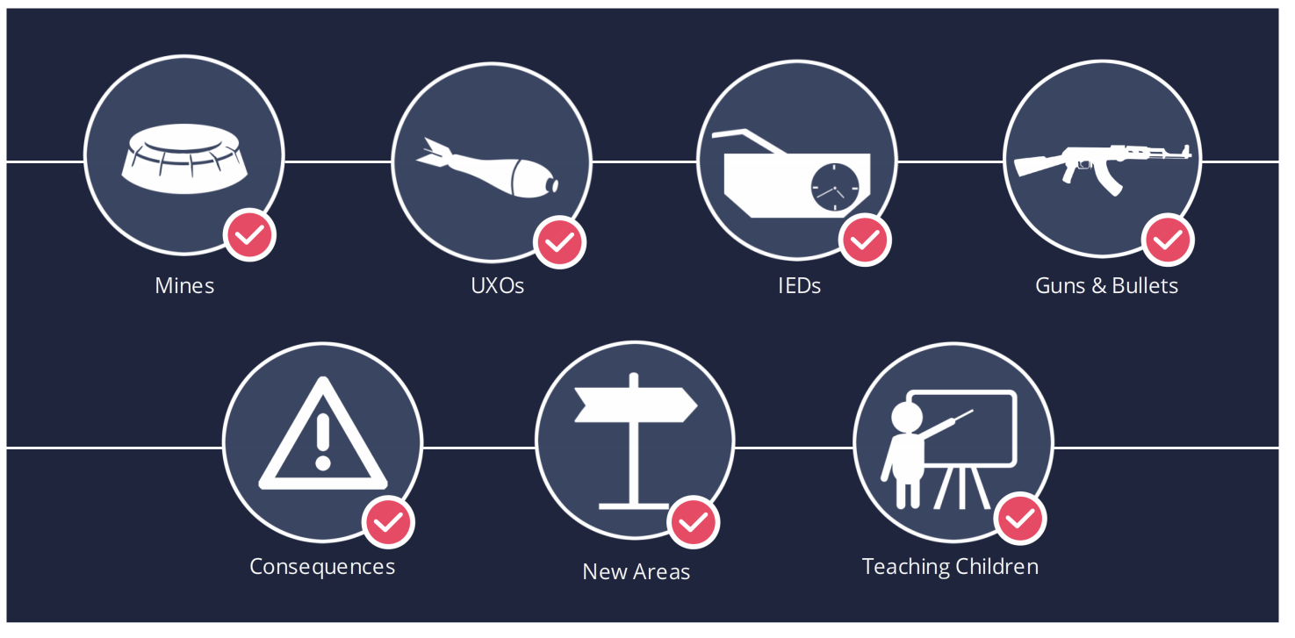
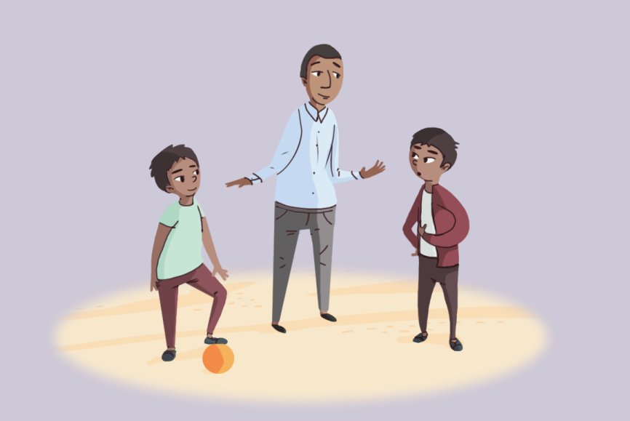
content
Training for teachers
  Risk Education
  Consequences
  New Area or Returning Home
  Teaching Children
Toolkit
  Activities
  Games

Slide 5
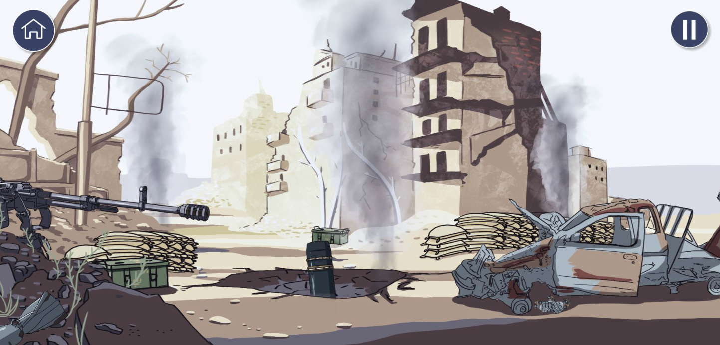
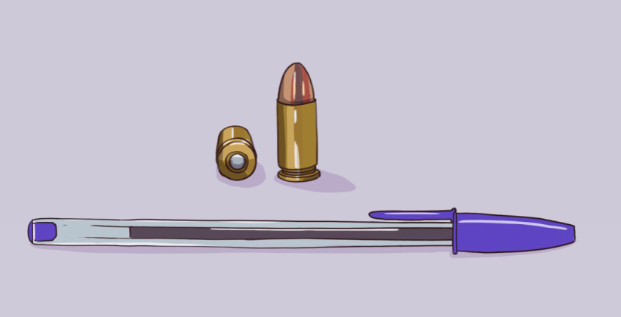
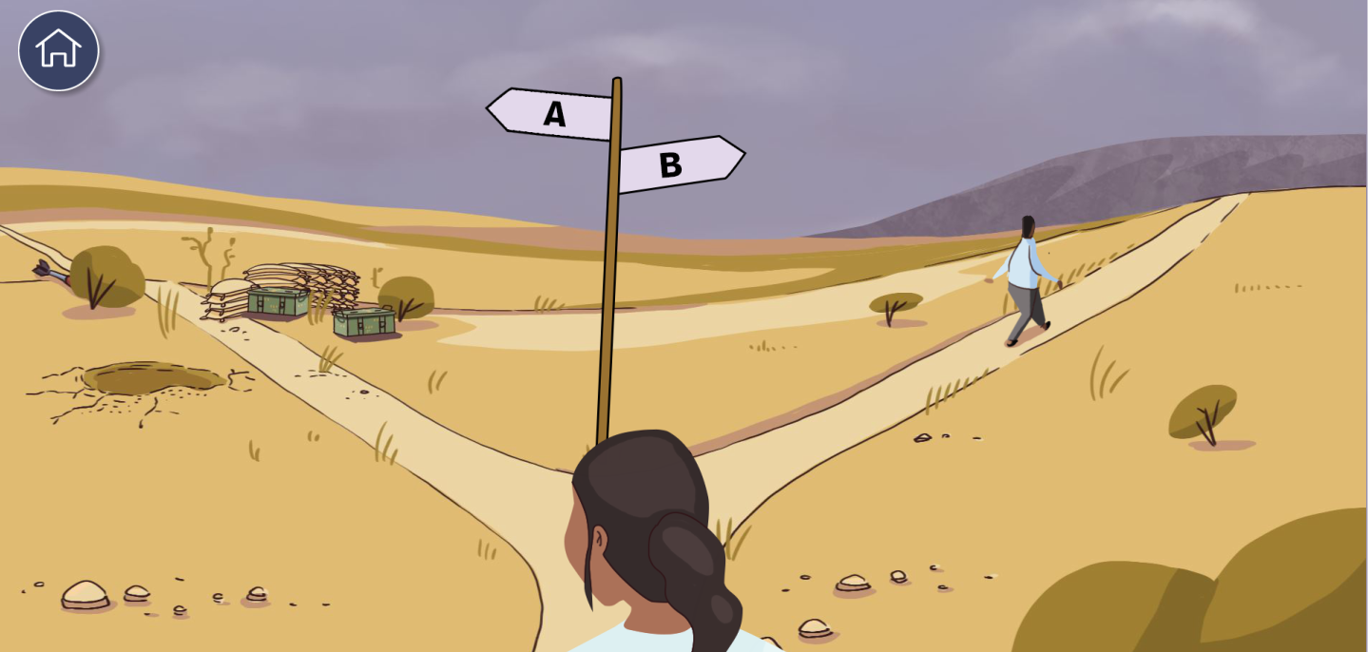
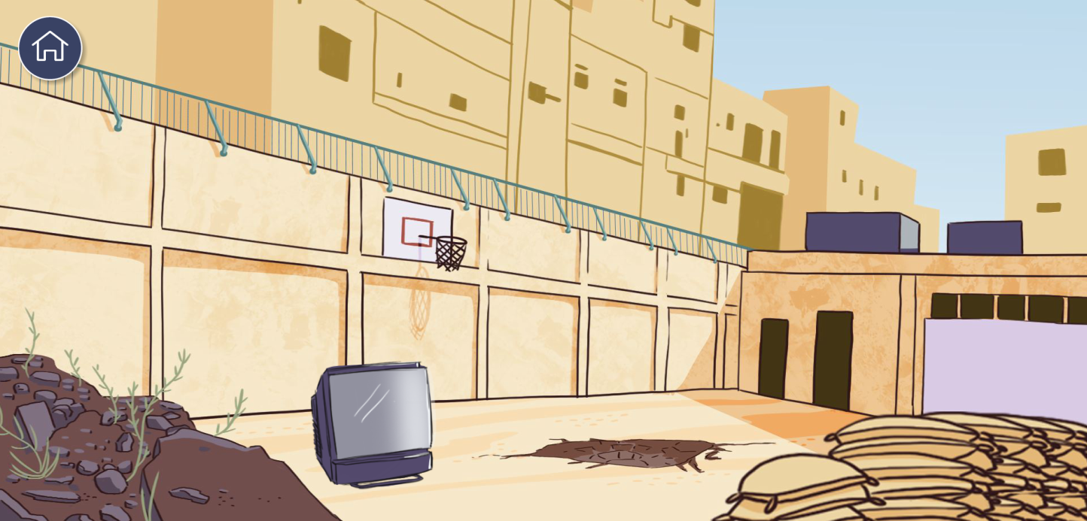
Risk Education Training - for teachers
UXO
  Item Recognition
  Recognizing Dangerous Areas
  Warning Signs
  Safe Behaviour
  Exercises
Mines
IEDs
Guns & Bullets

Slide 6

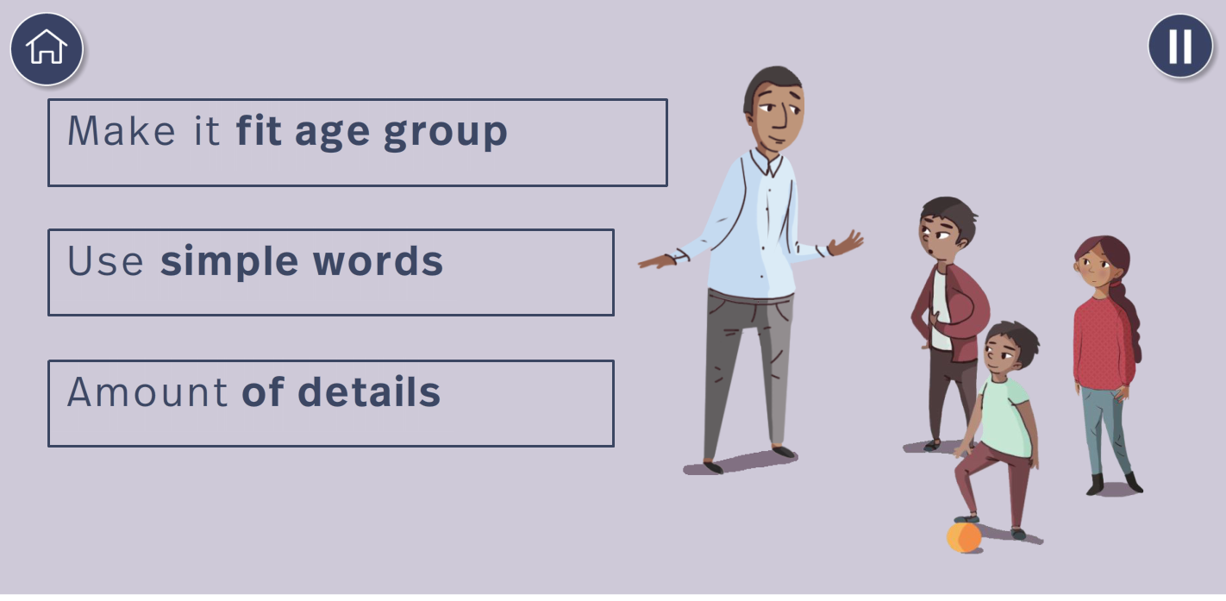
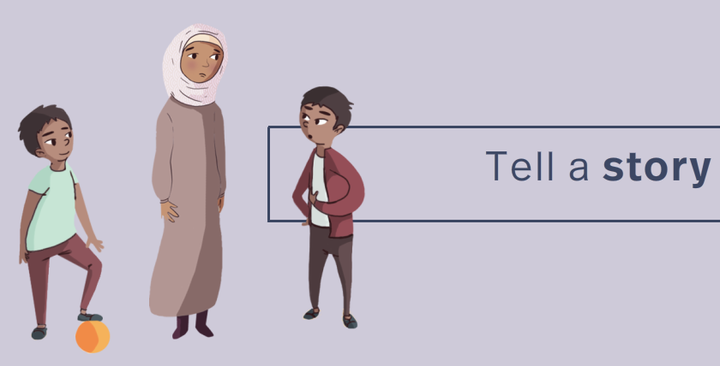
Teaching children
In Syria, many schools, also in besieged areas, are still functioning to a certain extend
Currently many ”teachers” are not trained teachers
The app includes a section on Teaching Children to equip teachers with the basic didactical knowledge on how to create a good learning environment for children

Slide 7
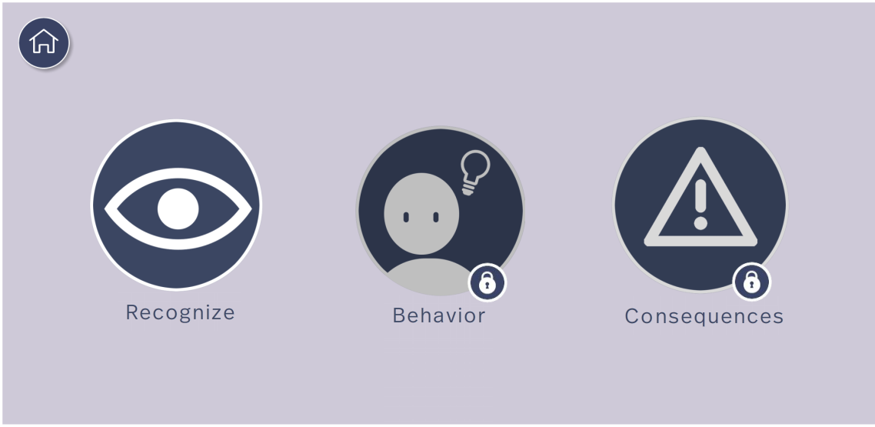
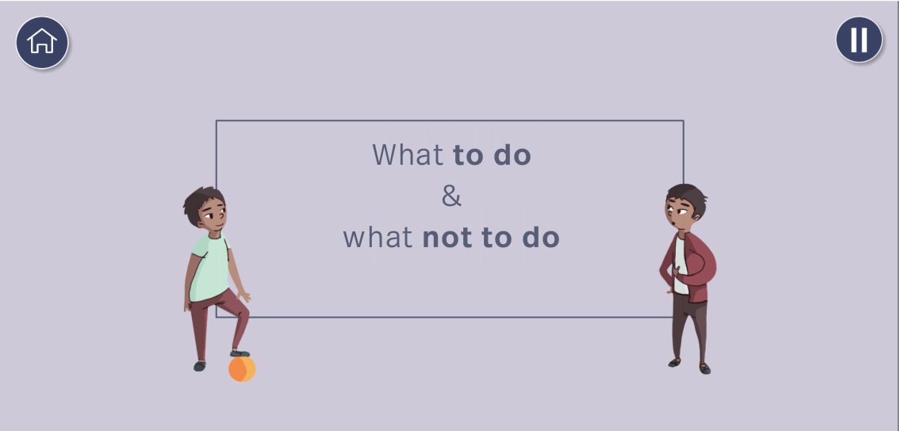
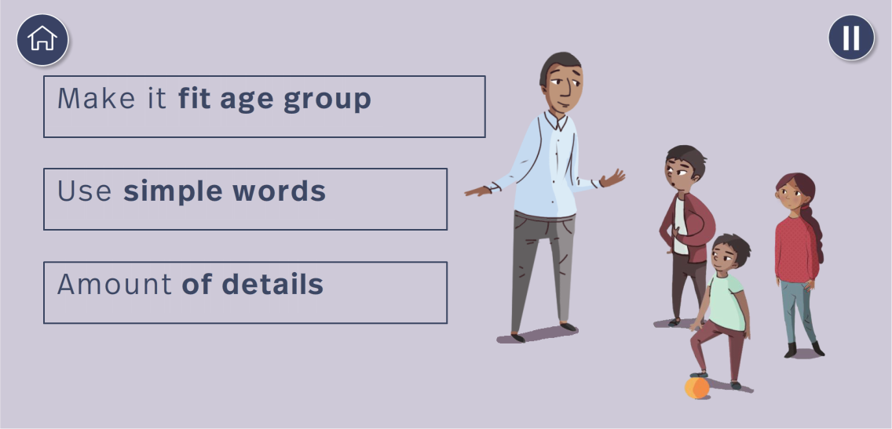
Learning flow
The RE app for Syria
Has been developed by LearningLab – a DCA unit dedicated to developing digital learning tools
Has been designed with learning design as a crucial aspect
Has been tested by a group of 20 Syrians
Makes extensive use of infographics and illustrations
Sections cannot be skipped
Includes
  Interactive exercises
  Summaries

Slide 8
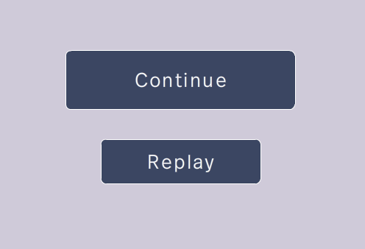
About…
The Risk Education app for Syria
has been tested to work on the oldest and the slowest smartphones
Is available on app and play store in English and Arabic
can be downloaded and used entirely off-line
has been made using tools which are very flexible and make changes easy to implement

Slide 9


About…

Slide 10
Risk Education App for Syria
Questions?

