Slide 1


Communication for development:
changing behaviour

Slide 2
Communication function
Media Relations
Communication for Development (C4D)
Advocacy
COMMUNICATION FUNCTION
Partnership
Fundraising

Slide 3
C4D Goes beyond providing information
raises awareness
changes attitudes expectations & practices
builds knowledge

Slide 4
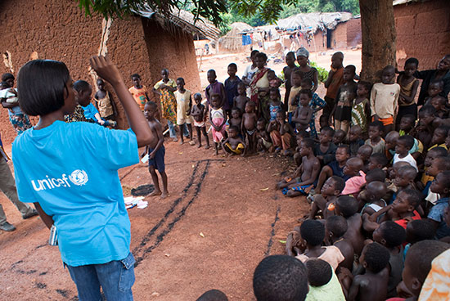
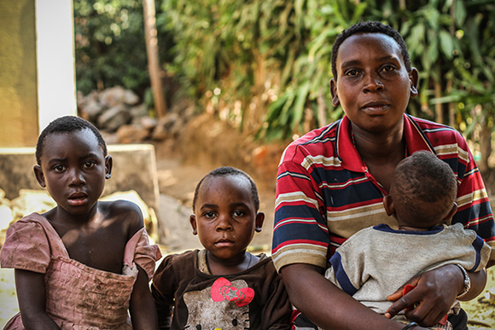
C4D Goes beyond providing information (2)
PEOPLE, THEIR BELIEFS & VALUES
SOCIAL & CULTURAL NORMS
Notes:
C4D involves understanding people, their beliefs and values, the social and cultural norms that shape their lives. It involves engaging communities and listening to adults and children as they identify problems, propose solutions and act upon them.

Slide 5
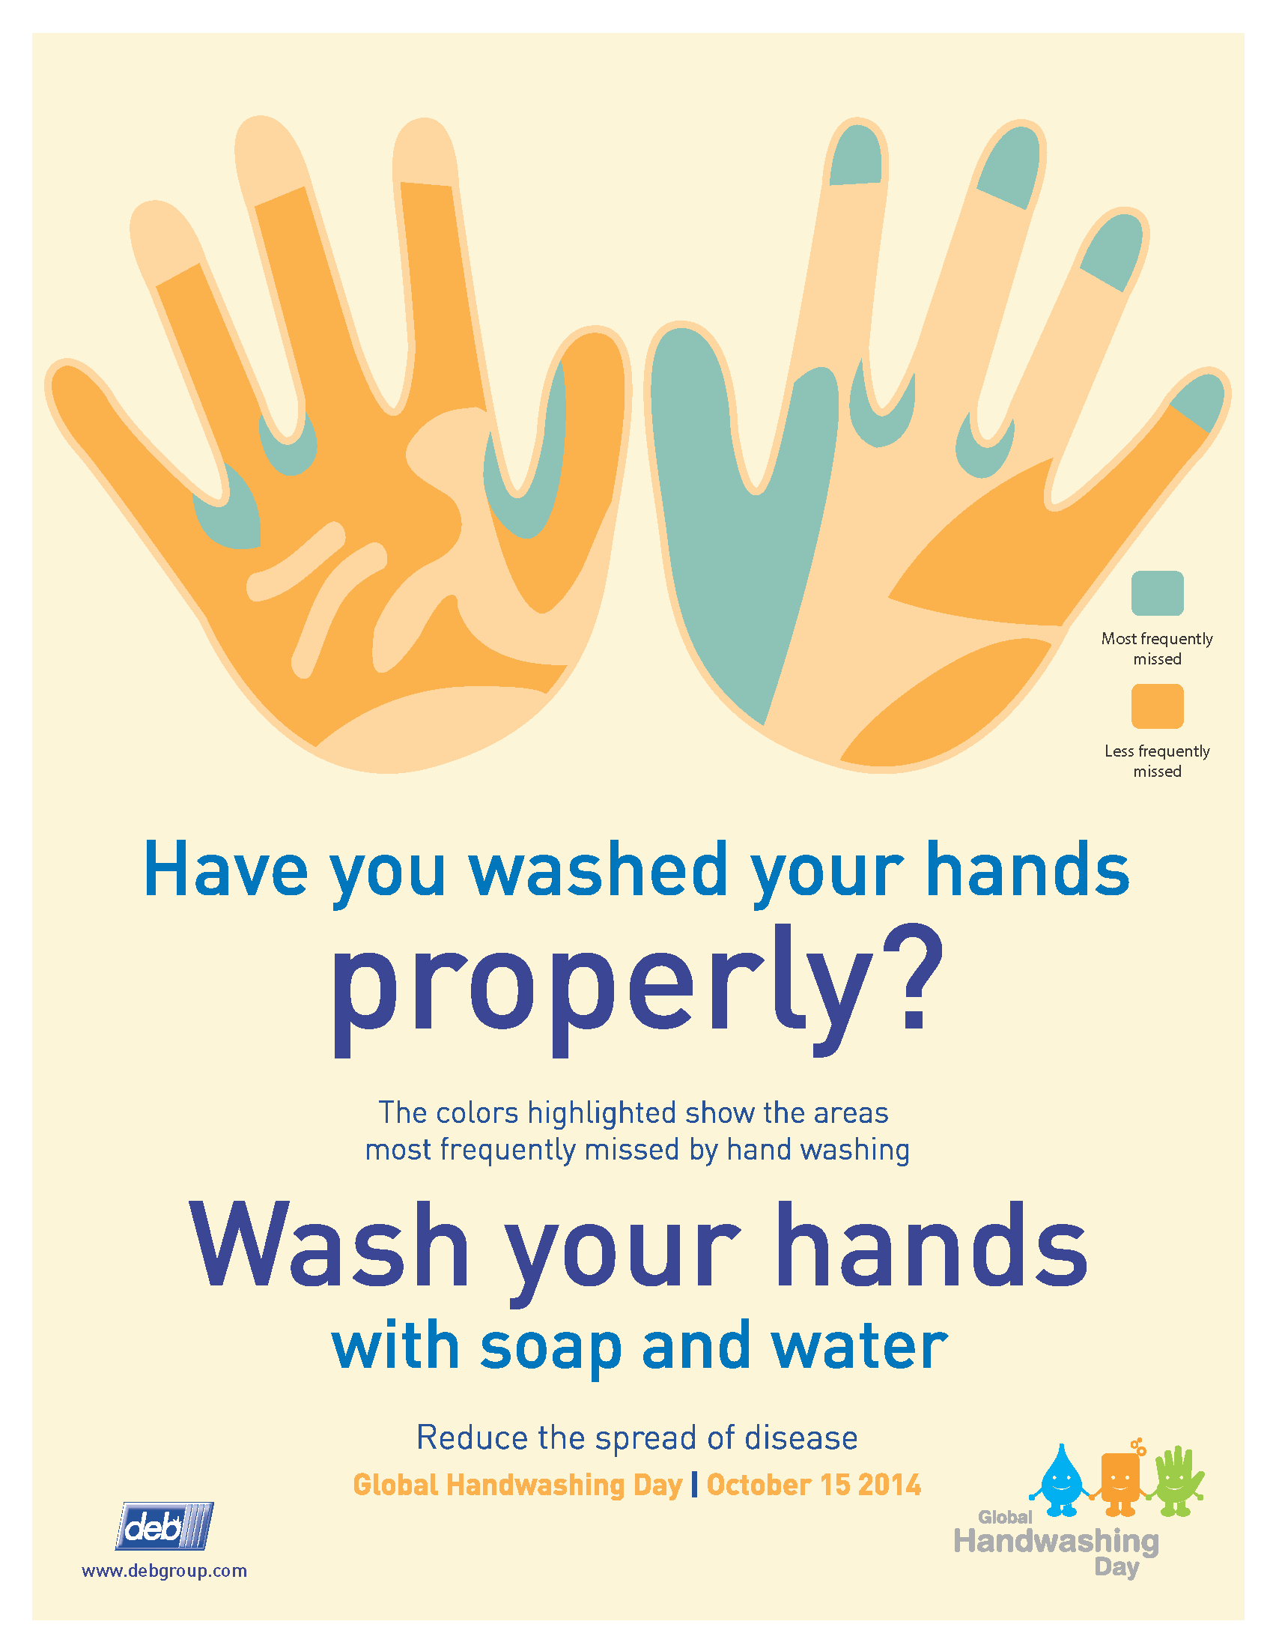
C4D campaign components
Information
Motivation
Knowledge and skills

Slide 6

KEY Success FACTORS for EFFECTIVE C4D
Identification of the barriers for behaviour change
Accurate target audience definition
Relevant content
Viral effect
Enabling Environment

Slide 7
Quality control
KAP before and after the campaign
Case investigation
Additional measurements (report, calls)
Campaign reach
Partner’s information

Slide 8
Iodine deficiency prevention 2013-2014
Digital outreach – over 230,000 people.
Outdoor adverts outreach – 70% of population.
Changed practice via integrated social marketing campaign:
‘I always try to buy Iodised salt’ increased from 24% to 41%

Slide 9

GET Tested on HIV 2014
Digital campaign on promotion of HIV testing among teenagers in YFC: in 2 target cities testing increased in 3.7 times, in 4 cities in 1.5 times. Campaign received 4 Awards at International festivals, and Effie Ukraine Award.
https://vimeo.com/113255139

Slide 10
Behaviour change comms on Immunization: changing positive perception of vaccination among parents

Slide 11

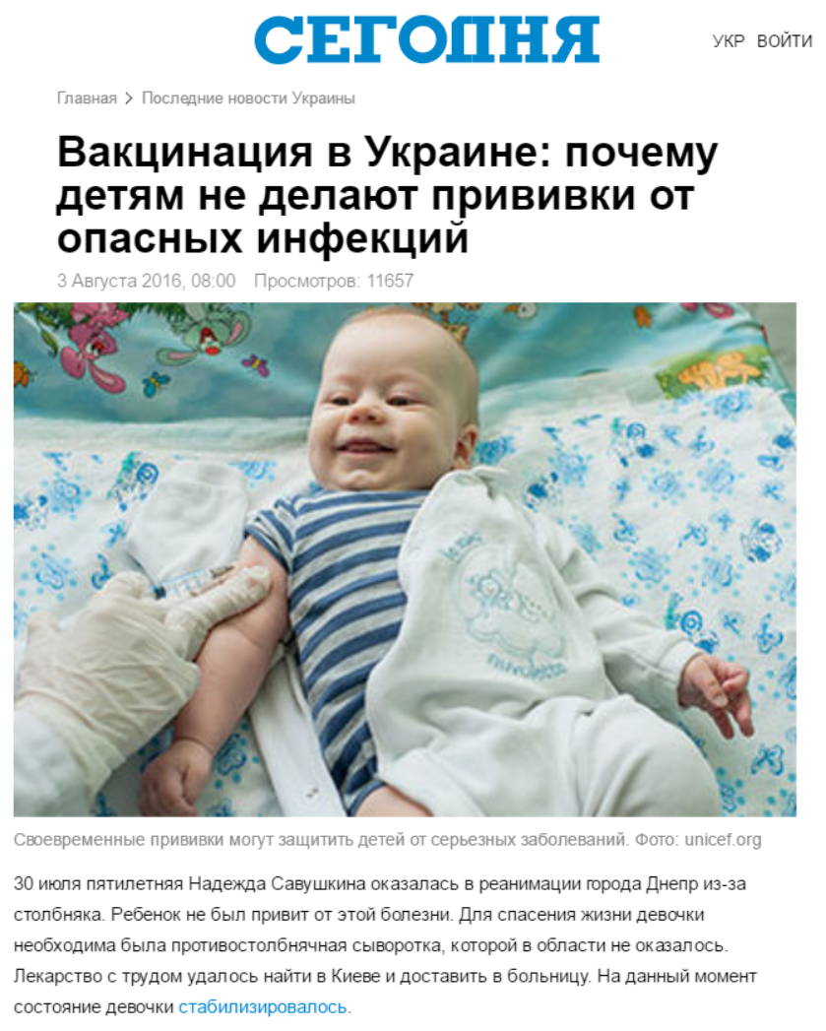
Changing public narrative about immunization
Media outreach and loyalty building:
increased number of balanced media reporting about vaccination, changing focus from danger from vaccines to risks from infectious diseases
2008
2016

Slide 12
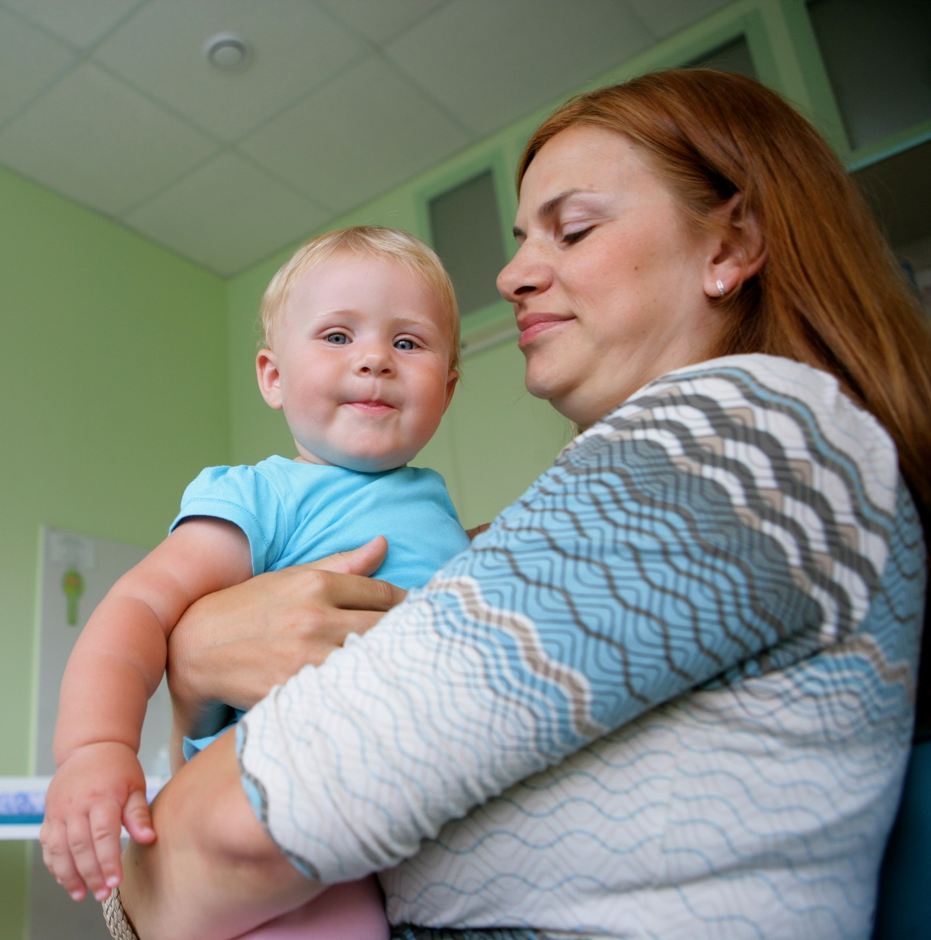
Main barriers towards vaccination among parents who refuse (research data)
Low level of knowledge about how vaccines work, about vaccine preventable diseases and its consequences
Low level of trust to efficacy and safety of vaccines, stereotypes about vaccine producers
General distrust towards health system in Ukraine
Deficit of proactive positive communication about vaccines benefit from medical workers
Necessity to sign consent form before each vaccination without adequate counselling about possible reactions

Slide 13
Decreasing barriers towards vaccination
Multi-media communication during 2009-2016 resulted in:
Reduction of the fear of complications 67% 2014 to 38% in 2016 among parents who refused from vaccination (during polio campaign)

Slide 14
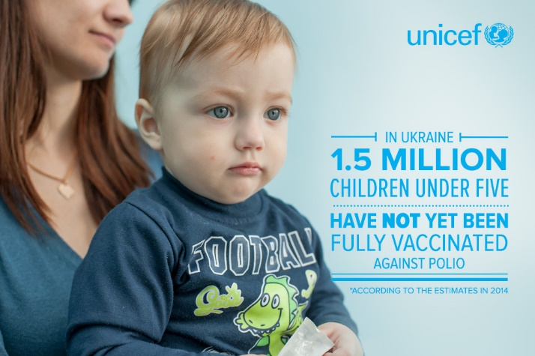
Decreasing barriers towards vaccination (2)

Slide 15
Capacity building & communication with medical community
Strategic communication among over 50 health managers in 4 regions (Zhytomyr, Iv-Fr, Odesa, Lviv), over 10 local comms strategies developed, partially implemented.
Media, messaging and crisis comms skills – all MOH top managers 2010-2017
Effective counselling on immunization & antenatal care- over 8,000 health workers in over 12 regions (oblast, rayon, primary level). Local trainers teams – over 200 health workers.
Series of National Workshops on Health Reform Communication – all regional health managers.
Summer School, Winter School – health management, public health, health comm

Slide 16

Outbreaks communication response
Simple Things Save Life: communication on H1N1 pandemic – the most viral health comm campaign in Ukraine.
Two month – reached over 60% people, 63% were motivated to follow recommendations.
Notes:
It is always important to address barriers to behaviour change. People think it is extremely difficult to quite smoking. This ad directly addresses that barrier by amplifying

Slide 17
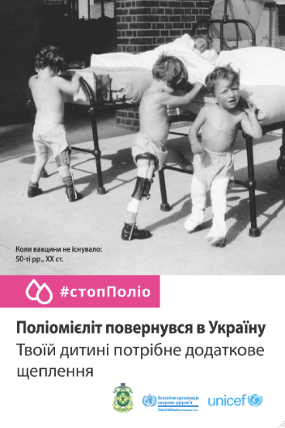
Outbreaks communication response (2)
Polio outbreak response: outreached over 70% of population via mass media, community mobilization, advocacy.
Awareness about polio from 68% (2014) to 96% (2016).
Polio causes paralysis - from 27% (2014) to 56% (2016).
57% people trusted credibility of the campaign advertisements,
42% asserting it helped them to make a decision on vaccination.
Notes:
It is always important to address barriers to behaviour change. People think it is extremely difficult to quite smoking. This ad directly addresses that barrier by amplifying

Slide 18
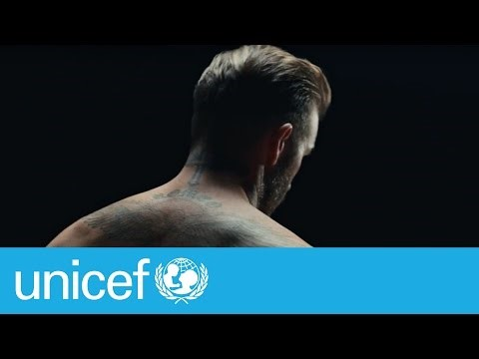
David Beckham: 18M total reach (Youtube, FB, Twitter) 4,800 site visits
https://www.youtube.com/watch?v=XwMITfK8vhc

Slide 19
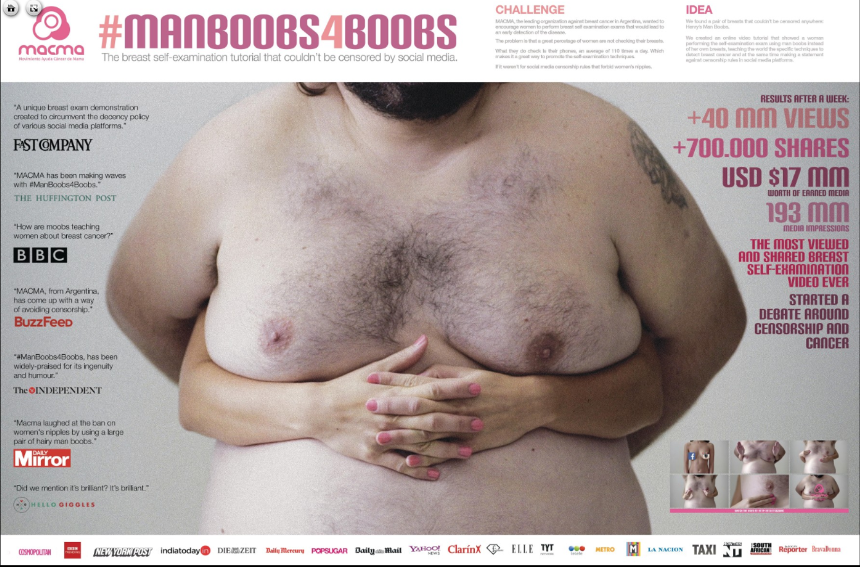
#MANBOOBS4BOOBS camapign: more than 48 ML views, 700k shares
https://www.youtube.com/watch?v=fz4c9zrVZZk
Notes:
The campaign won mobile gold award at the 2016 Cannes Lions International Festival of Creativity, for its innovative campaign to help women learn how to examine themselves for breast cancer. MACMA wanted to create tutorials that showed real breasts and how to check yourself for cancer, and post them on their Youtube, Facebook, and Instagram pages. Yet, such social media sites have strict rules against nudity. They do not allow female nipples to be shown on their sites unless they have mastectomy scars. Yet, these sites do permit men’s nipples to be shown. MACMA decided to take a stance on this double standard while also promoting self breast examinations by using man boobs instead of female boobs.
The video teaches people how to examine their breasts for cancer, promotes awareness that men can get breast cancer too, and challenges the double standard of censorship laws on social media platforms.
The campaign accrued 48 million views in its first week and gained coverage, not only in Argentina, but in every continent with 193 million total impressions. MACMA’s social media followers increased by 20,000 people and their tutorials were shared over 700,000 times.
Social media’s censorship rules almost helped MACMA’s campaign become so viral because of the taboo nature of examining a man’s breast instead of a woman’s. #ManBoobs4Boobs helped attract doctors, patients, volunteers and benefactors to support MACMA in their goal to promote methods of early breast cancer detection.

Slide 20
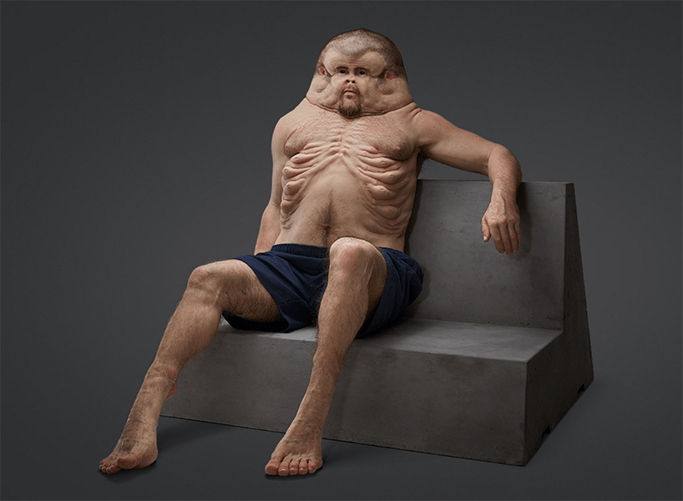
Meet Graham: The only person designed to survive on our roads
https://www.youtube.com/watch?v=0r9u7Rn-nm0
Notes:
Clemenger BBDO Melbourne has won the first Grand Prix of this year’s Cannes Lions for “Meet Graham,” the road safety campaign that imagined what humans would look like if our bodies evolved to withstand car-crash forces.
The campaign won the Grand Prix on Saturday night in the Health & Wellness category of the Lions Health festival. It also won a gold Lion, three silvers and a bronze.

Slide 21
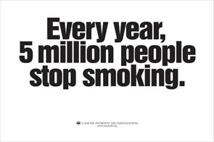
Encourage people to change behavior
Notes:
It is always important to address barriers to behaviour change. People think it is extremely difficult to quite smoking. This ad directly addresses that barrier by amplifying

Slide 22
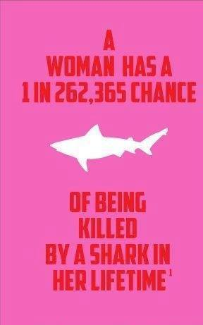
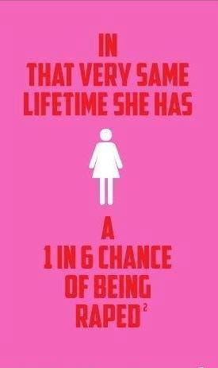
A lot of problems are exaggerated. Play with them
You can always play with the contrast messages and things that worry people a lot

Slide 23

Thank you!

