Slide 1


Mine Risk education:
Ukraine case

Slide 2
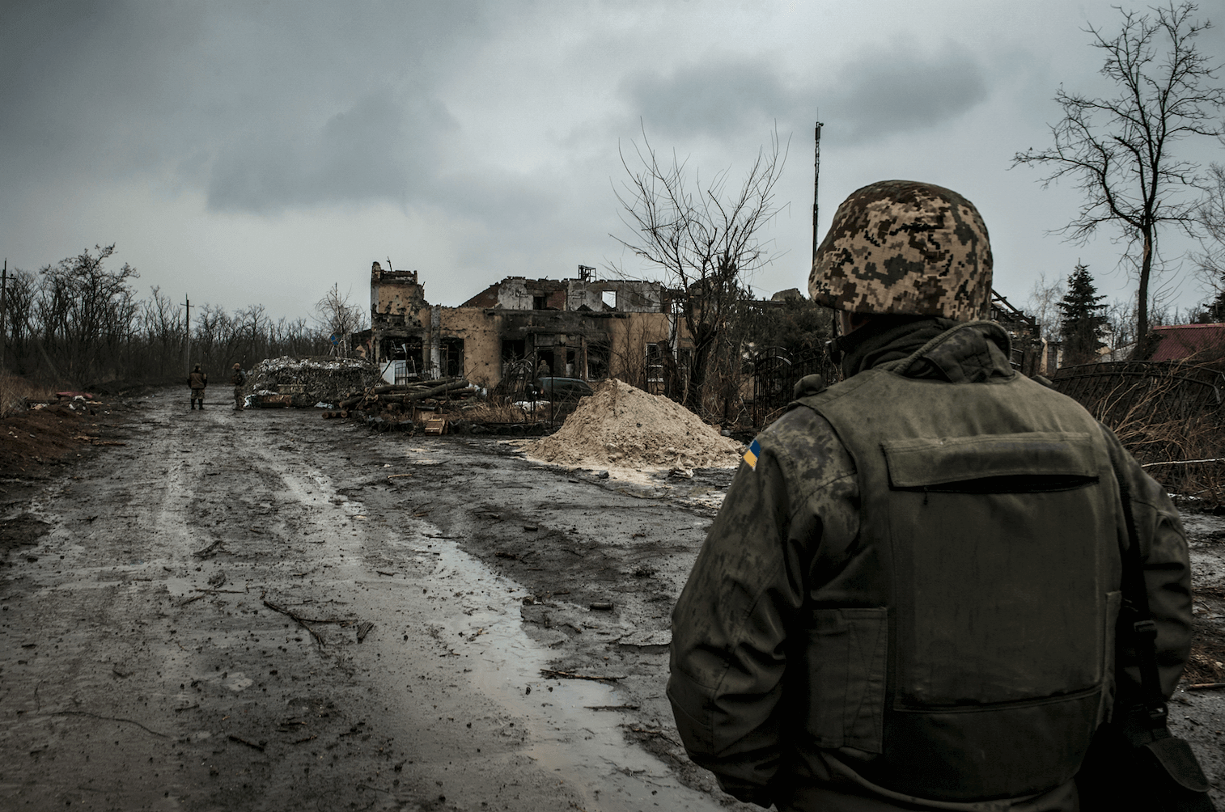
The Conflict in Ukraine
started in November 2013
uprisings and unrest in Donetsk and Luhansk oblasts of Ukraine evolved into an armed conflict.
With the exception of air-launched weapons, the full arsenal of conventional weapons available to both sides has allegedly been used.
As a result of the crisis, the protection needs of civilians have risen significantly

Slide 3
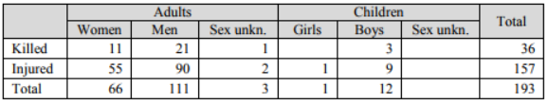
Victim Data collection
No official data on the number of the civilian victims of mine accidents and ERW. OHCHR reports are the main source of information;
Between 16 Feb and 15 May 2017 OHCHR recorded 193 conflict related civilian casualties. 86 of those happened because of mine, ERW, booby traps or IEDs.
Notes:
Credible reports were received from DDG, Human Rights Watch, International Committee of the Red Cross (ICRC) and the State Emergency Services of Ukraine (SES) of widespread use of mines and booby traps, particularly around military checkpoints and in the lines of separation. In addition to this there is evidence to show that artillery shelling and cluster munitions have been widely used by both sides. There are anecdotal reports of landmine/unexploded ordnance/improvised explosive devices (UXO/IED) casualties in the media, but whilst data on these incidents is collected by various government ministries, it is not at present publically available. 34% - women, 57% men. 7% children.

Slide 4
Conflict-related civilian deaths in Ukraine 24 April 2014 to 15 May 2017
Notes:
C4D involves understanding people, their beliefs and values, the social and cultural norms that shape their lives. It involves engaging communities and listening to adults and children as they identify problems, propose solutions and act upon them.

Slide 5
Assessment of the comm channels
Notes:
% of the children who defined the

Slide 6
Multi media c4d campaign
Digital advertisement campaign – web sites (kids and adults, Bloom video).
Billboards in the relevant oblasts and checkpoints;
Printed materials at the checkpoints;
Comic books, daybooks and leaflets in the schools;
Direct sessions on MRE with children in the schools;
Training of trainers on MRE in the schools;
PSAs in the trains from and to the relevant regions;

Slide 7
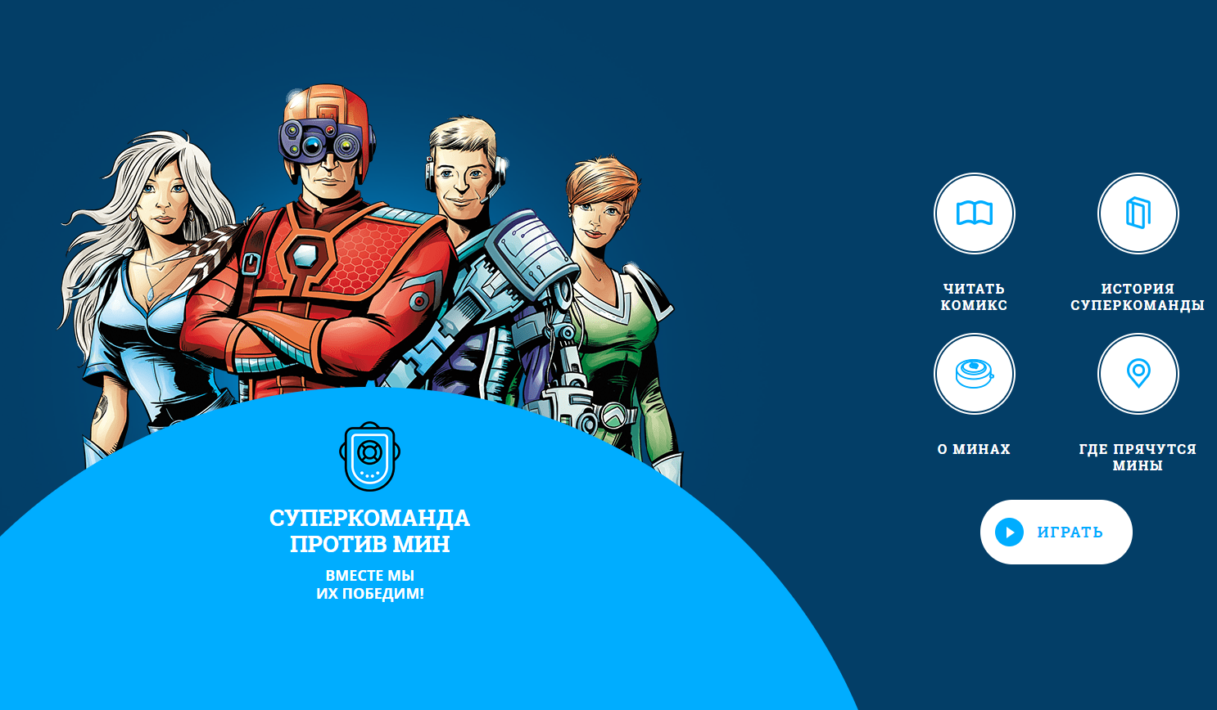
Superheros campaign: Web site for children & comic Books
Received gold Effie award
www.inforce.team

Slide 8
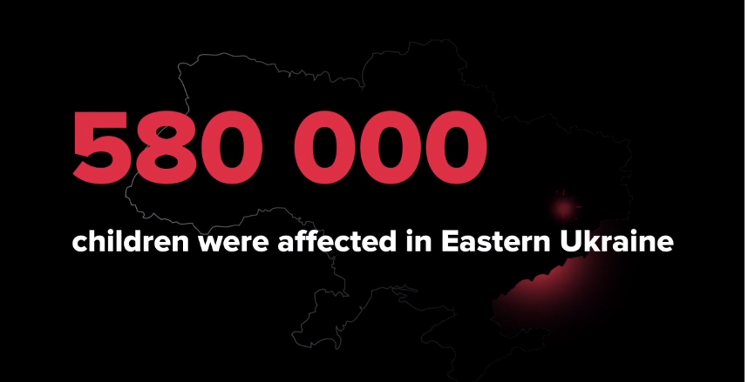
Superheros Campaign
Video case
https://youtu.be/6jFgOAiM2-A

Slide 9
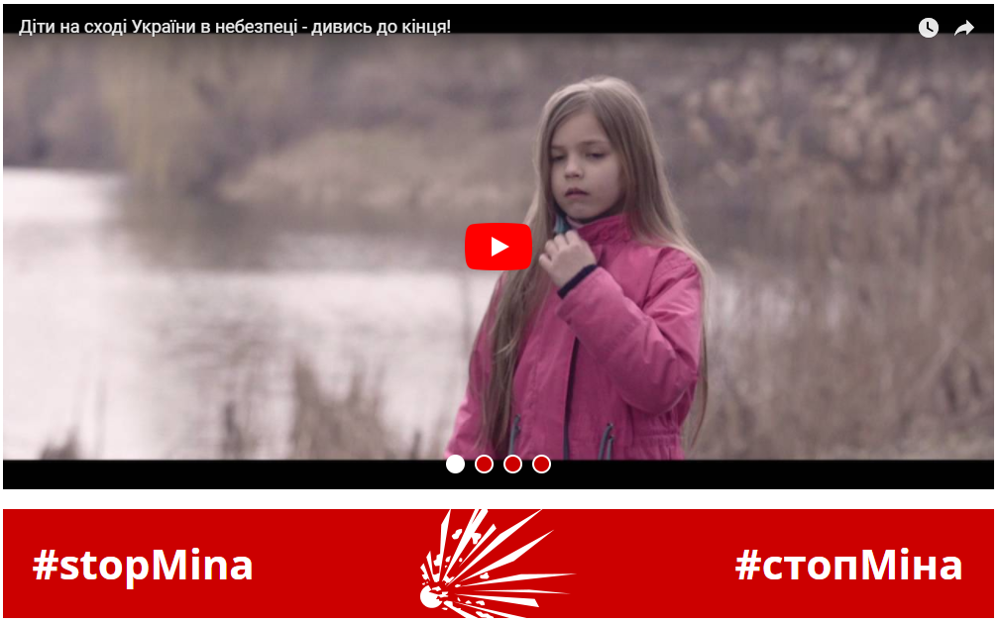
Web site for adults
www.stopmina.com.ua

Slide 10
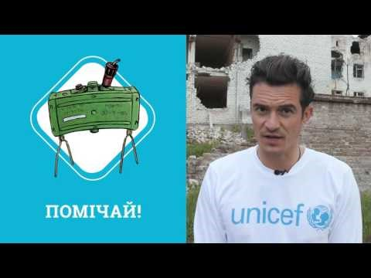
Orlando Bloom
https://www.youtube.com/watch?v=pF5NmNn_ANo

Slide 11
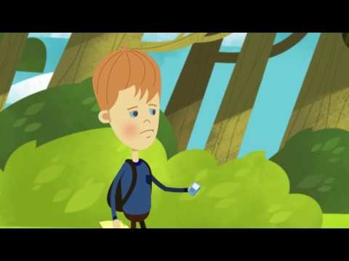
Cartoons for kids
https://www.youtube.com/watch?v=V5JZWI8TrEY

Slide 12
Campaign results
More than 500,000 children and parents were reached through mine risk education interventions in Donetsk and Luhansk regions.
The campaign for teenagers, which received a Gold Effie 2016 prize, reached more than 87% of children aged 6–11 years living in conflict-affected areas.
The teenagers’ campaign increased the level of knowledge on key safe behaviours at an average of 12 per cent.

Slide 13


COMPARISON BETWEEN THE BASELINE AND ENDLINE: Children school age

Slide 14
Communication Priorities 2017
Audiences
School aged children (6-11 priority)
Parents of children
Teachers
Government
Digital info campaign/ edutainment&comic cartoons;
Direct sessions;
TOT and peer-to-peer training sessions
Direct sessions and billboards
Capacity building: TOTs
Capacity development for mine victim data collection

Slide 15

Thank you!

