Slide 1
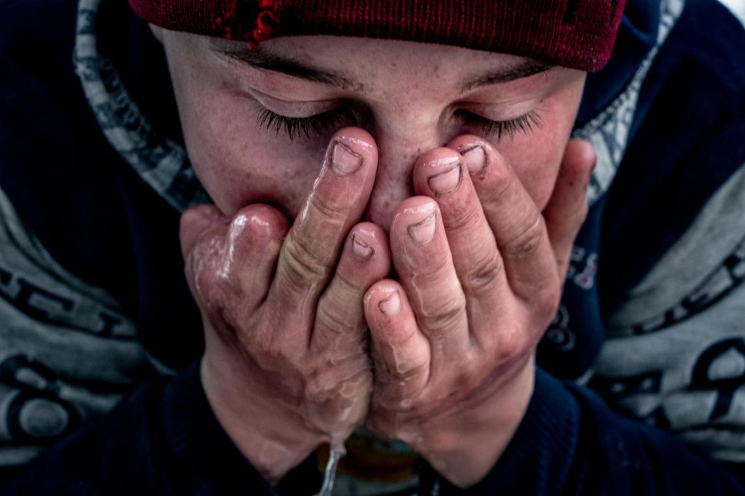
EORE FOR
CHILDREN
IN UKRAINE
UNICEF approach

Slide 2
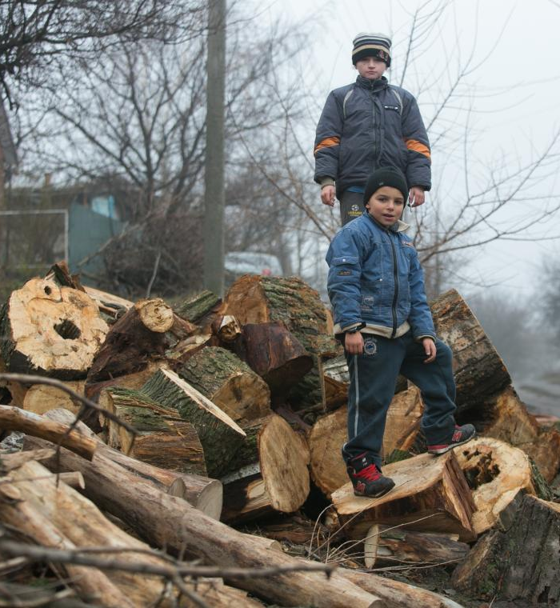
TARGET AUDIENCE
Pre-school and primary school aged children who are the most vulnerable
Only 57% below 12 years can identify dangerous objects
56% below 12 years do not know or are not sure what to do when seeing such an object
* KAP survey, UNCIEF Ukraine, 2016

Slide 3
EORE FOR CHILDREN IN UKRAINE. 2015-2019
from TRADITIONAL TOOLS
to EDUTAINMENT APPROACH
Billboards in East Ukraine with a focus on checkpoints (GCA);
Printed materials at checkpoints, schools (GCA)
Direct training sessions on mine safety in schools (GCA)
Training of Trainers on EORE in the schools (GCA)
Comprehensive digital advertising campaign based on 4 superheroes with different role models:
comic books, cartoons with superheroes – each story dedicated to specific mine safety rule;
web site for children with games;
branded copybooks, coloring sheets for team work, posters with Superheroes for schools
Web site StopMina.com for adults with useful information
Cooperation with popular Youtube bloggers Kreosan
Peer to Peer trainings for direct communication
Screening comic cartoons on ChildrenKinofest (GCA)

Slide 4

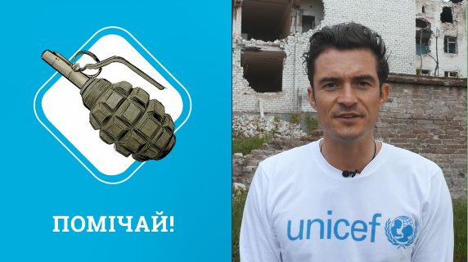
SUPERTEAM AGAINST MINES
Superheroes with different role models: Notice! Bypass! Report! Don’t panic!
3.1 M children reached online
500,000 received education materials 200,000 were trained
Additional video engaging Orlando Bloom, popular local Youtube bloggers watched by 3M people.

Slide 5
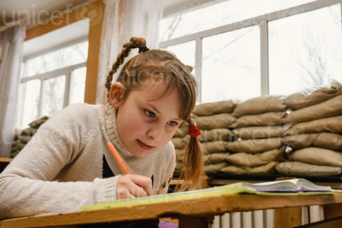
RESULTS
Campaign reached over 87% of children aged 6–11 years living in conflict-affected areas
Among children in affected areas:
Knowledge, intended practice of safe behavior when observing mines increased by 12%
Ability to identify risky areas among children increased by 15%
Ability to identify suspicious, dangerous objects increased by 20%
Won Gold EFFIE Award, 2016

Slide 6

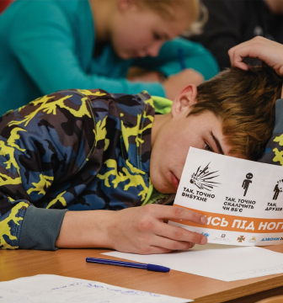

LESSONS LEARNT
Motivating safe practices effective through educational entertainment in humanitarian context.
WHY?
Teenagers less receptive to traditional media, lower risk perception, eager to try new things.
Positive, empowering behavior change communication for conflict affected audiences.
Traditional communication showing consequence of unsafe practices can do more harm. Children already traumatized, face psychological distress.
High potential for reach in inaccessible areas

Slide 7

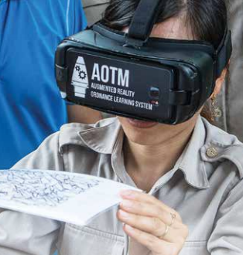
PRIORITIES 2020-2021
After 6 years of conflict more profound edutainment approach is required.
VIRTUAL REALITY (VR)
and AUGMENTED REALITY (AR)
Children will get the very first VR and AR experience and information will definitely get into long-term memory
3 tailored VR / AR videos tailored for:
primary school, secondary school and adults.

Slide 8
PRIORITIES 2020-2021
Children
(5-13 y.o.)
Caregivers of school-aged children
Teachers
Government
Direct EORE training sessions focused on VR/AR in school
Peer-to-peer trainings using VR/A
Lesson on mine safety rules included to curriculum for school-aged children
Household visits with focus on VR/AR
ToT sessions
Series of ToT sessions with focus on VR/AR
guide for teachers on lesson on mine safety rules
Capacity development on mine victim data collection
Professional support of Mine Action Center
Guide and Lesson on Mines/ERW Safety rules for teachers
to reach 200,000 children (along the contact line in East Ukraine)

Slide 9
thank you!

