Slide 1
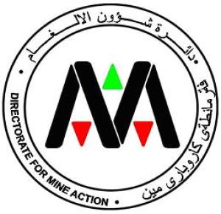
Republic of Iraq
Ministry of Health and Environment
Directorate of Mine Action ( DMA )
The Use of Virtual Reality in Mine Action
13 February- 2020 - Geneva
Eng. - Khalid Rashad Jabbar - National Director
Directorate of Mine Action Iraq

Slide 2

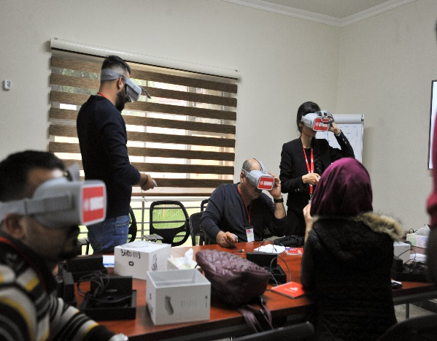
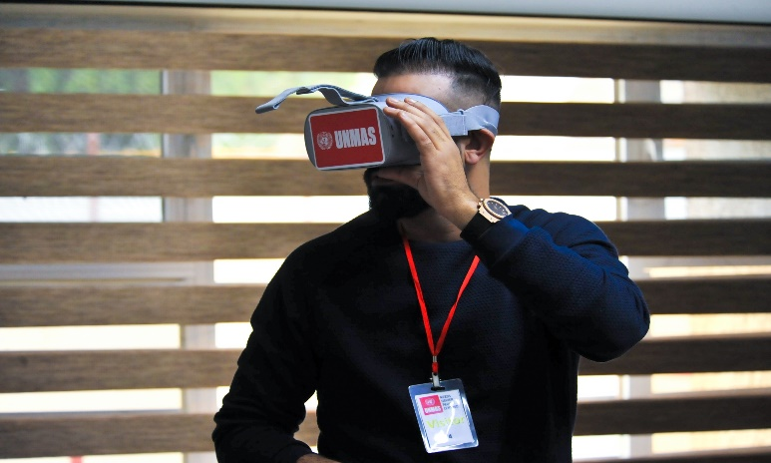
MRE Activities
Since November 2018, DMA and IKMAA have dealt with UNMAS in Iraq who have been using virtual reality (VR) goggles as an auxiliary tool for explosive hazard awareness sessions for humanitarian workers.
Virtual reality goggles emulate a contaminated area that contains typical signs of risk in urban and rural areas. These goggles enable humanitarian workers to observe signs and signs of explosive hazards present in Iraq in 360 degrees.
IRAQ- Directorate of Mine Action (DMA)

Slide 3
RE Activities
• The use of VR goggles aims to enhance the ability of the local community and humanitarian workers to identify dangerous elements and encourage the utmost caution in this area.
More than 2000 Person and humanitarian workers have benefited from these goggles in Iraq, especially in Baghdad, Erbil, Mosul and Anbar.
• The feedback from these goggles is largely positive. Participants indicated that the experience of virtual reality goggles is very useful and practical, providing an interactive and distinctive experience. MA, Iraq
IRAQ- Directorate of Mine Action (DMA)

Slide 4
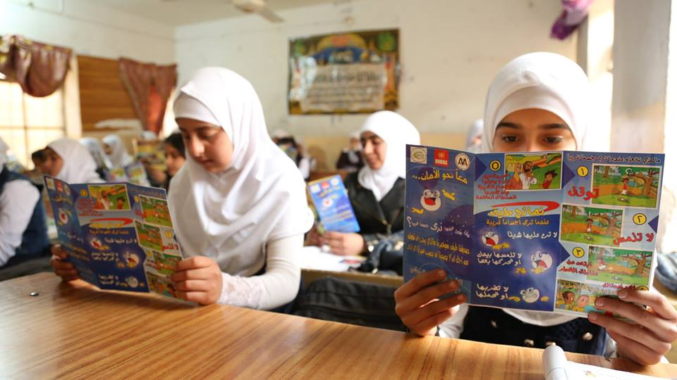
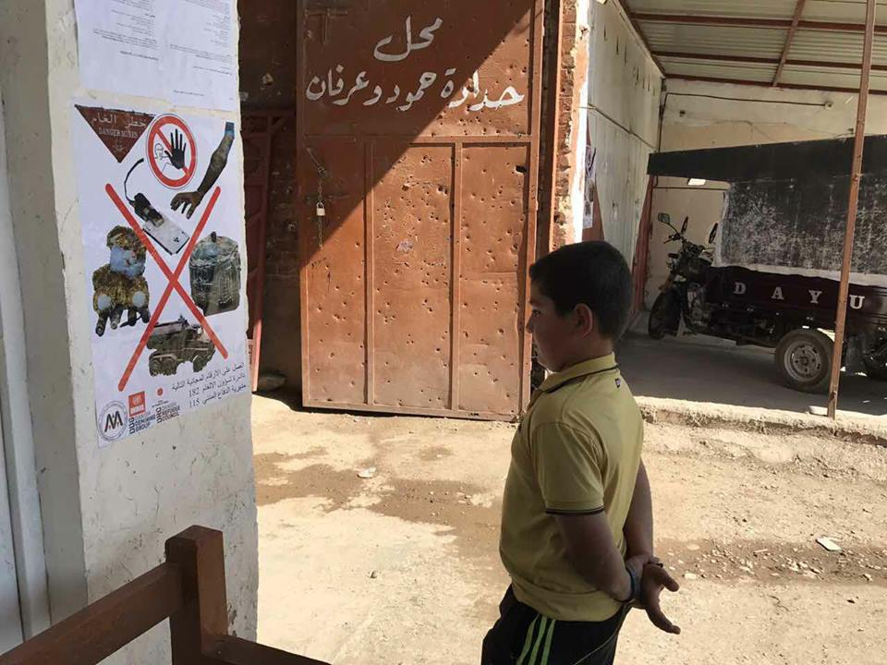
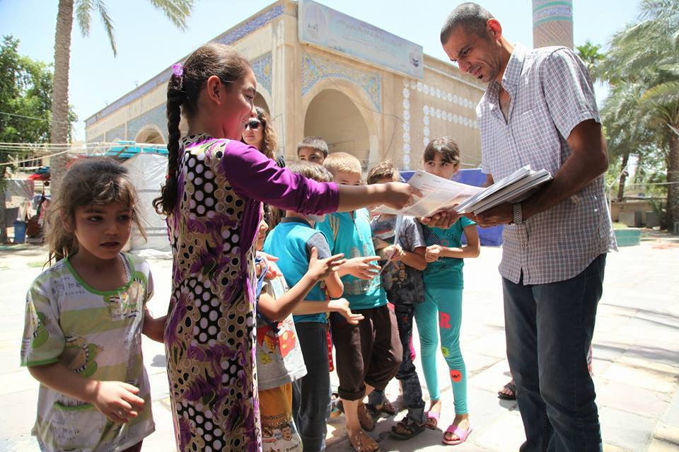
RE Activities
We also use other outreach methods such as posters, notebooks, school curricula, and audio-visual media such as local satellite channels, radio, and social media like Facebook and websites. Toll free number 182 and SMS text messages.
IRAQ- Directorate of Mine Action (DMA)

Slide 5
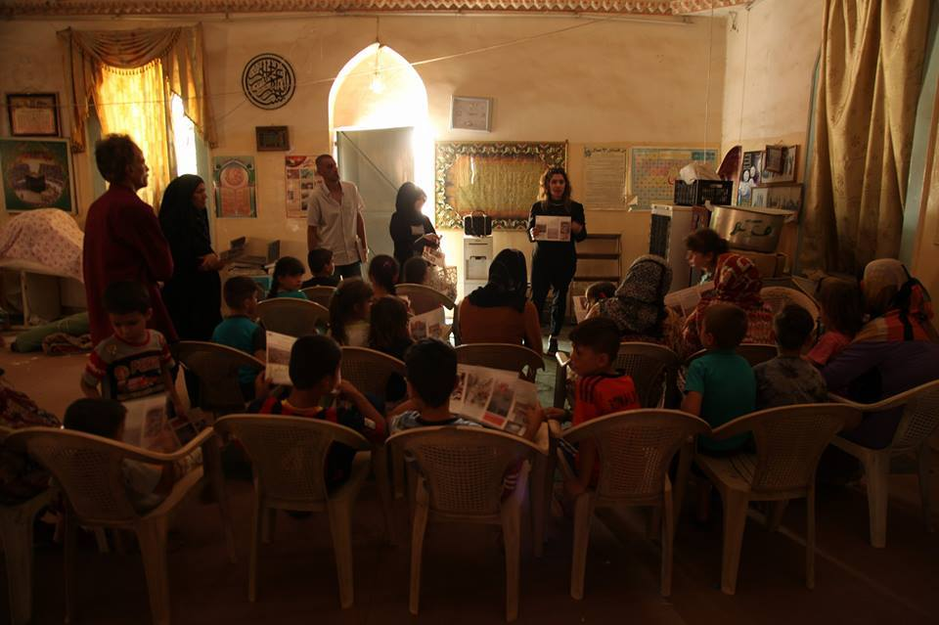
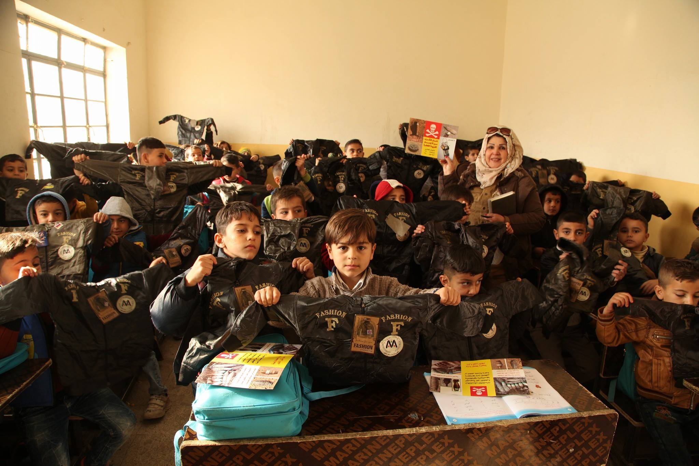
Raising awareness of the dangers of mines and IEDs in IDP camps to ensure safe return to their homes and adopting safe behavior
IRAQ- Directorate of Mine Action (DMA)

Slide 6
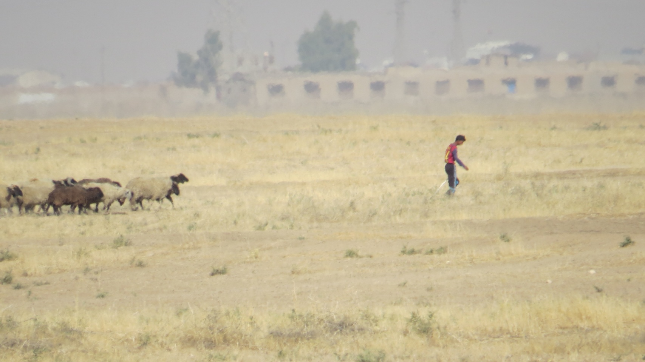
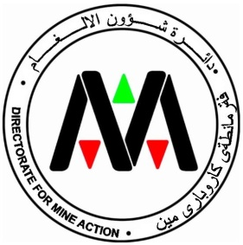
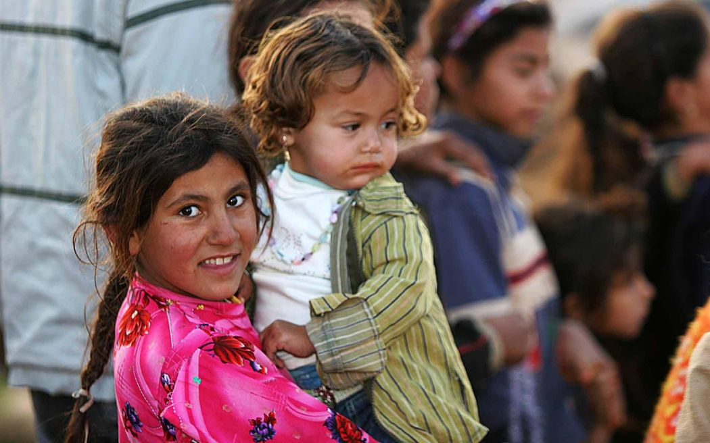
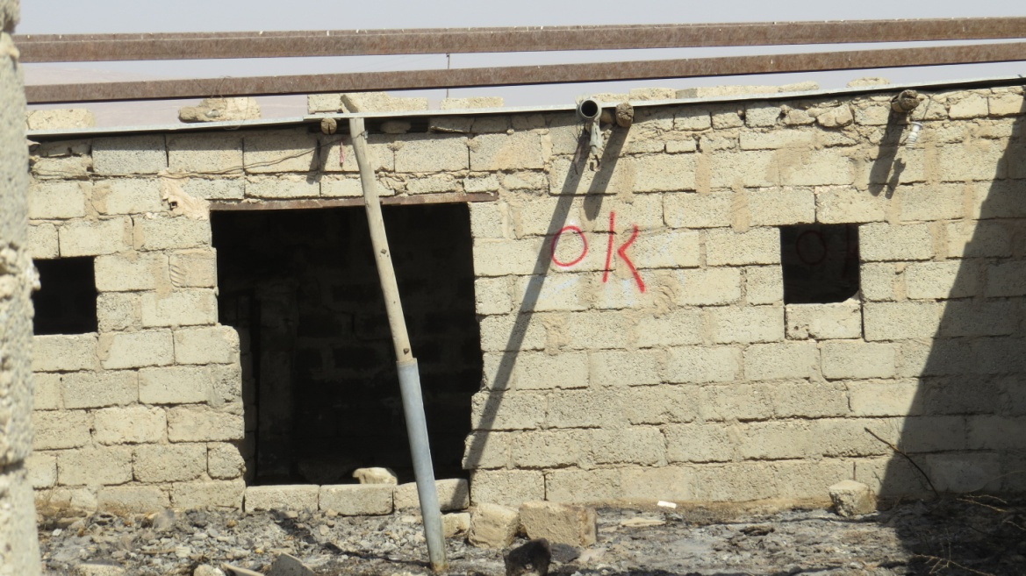



Thank You
Contact us:
Dma_moen@yahoo.com
muameralhete@yahoo.com
00964 7704717136
00964 7902328354
Miningactioniraq
IRAQ- Directorate of Mine Action (DMA)

